Slide 1


Risk Mitigation training
Readiness and resilience

Slide 2


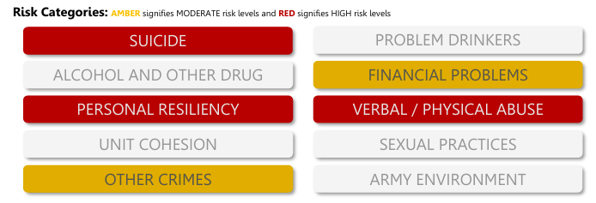
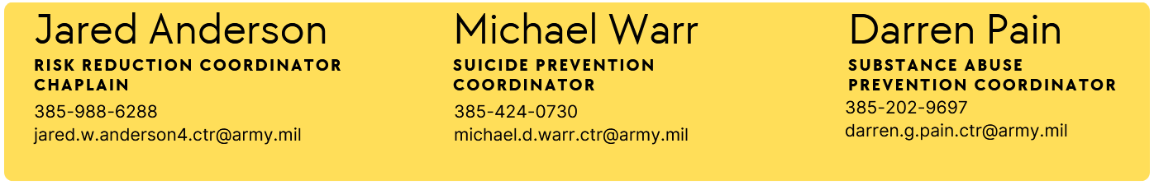
Risk Factors

Slide 3

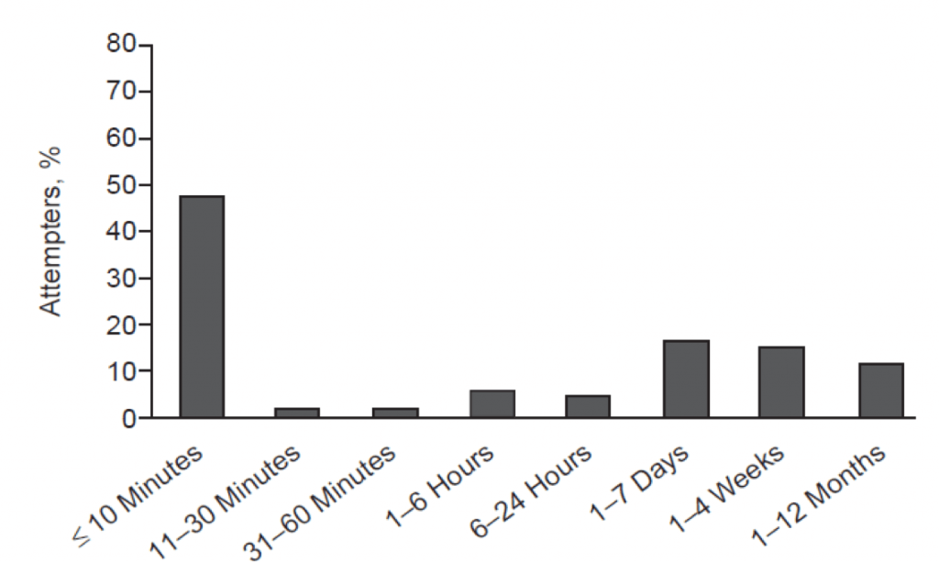
Scope of suicidal impulse
71%
< one hour
Notes:
As you apply ACE-SI, one of the most important things to remember is that active suicidal impulse is usually very brief. We only need to hold on for a matter of minutes (Story of Cottonwood traffic saving a Soldier’s life)

Slide 4
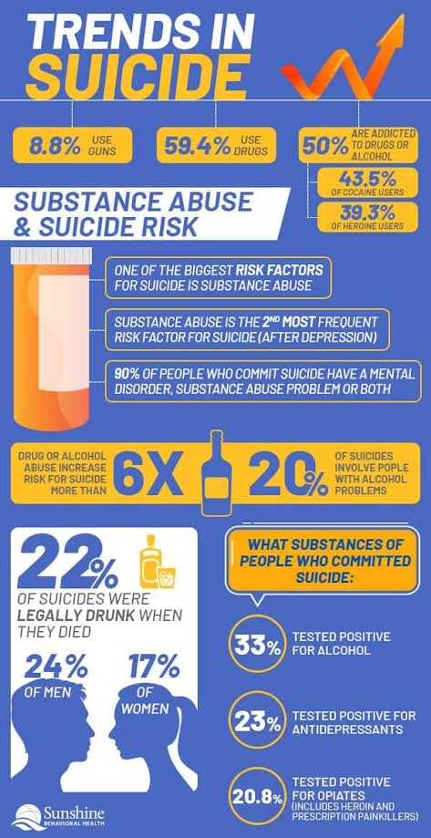

Senseless suicide

Slide 5

ASAP Program
Substance Abuse Program Initiation
  UA Positive
  Self Referral
  Commander Referral
Commander Counseling
Soldier contacts Psychological Health
ASAP team supports Soldier

Slide 6
The limited use policy
Qualifications:
A soldier must meet the following qualifications in order to be covered by the Limited Use Policy:
Voluntarily self-refer to their Commander, a military Chaplain, the SAP office or an NCO or officer in their Chain of Command.
    If the Soldier self-refers to their Chaplain, they must allow the Chaplain to inform Command in order for the Limited Use Policy to apply.
The Soldier must not have knowledge of a pending urinalysis or alcohol test.
The Soldier must provide the Commander with the facts and circumstances of drug and/ or alcohol use.
    When providing the Commander with the facts and circumstances of drug use, the Soldier must self-refer to all drugs they used.
    ***See complete policy for a more comprehensive understanding of the Limited Use Policy or call your RRC
Notes:
Take accountability. If you have a problem, talk to your Commander. The Limited Use Policy is not a “Get out of Jail Free” card. You can only use it once. When you self-identify, you must self-refer regarding ALL drugs used, not just one. This is some of the criteria of the Limited Use Policy. You can look in the AR 600-85 if you want to know more.

Slide 7
What are you getting out of this?
Substance | Motivations | Healthy Approaches
Alcohol | Escape/Avoidance/Coping Winding down/relaxing Social connection or pressure Sense of control (all) | Breath work and meditation Relationships/support systems Alternative drinks/rituals
Marijuana | Sleep Anxiety management Social connection Mental health symptoms | Spirituality/rituals Sleep hygiene Hobbies (all)
Opioids | Pain management Euphoria Escape/avoidance/coping | Meditation Grounding/ Mindfulness
Stimulants | Functioning Focus Energy management Deal with pressures/demands | Caffeine in moderation Breath work Exercise

Slide 8
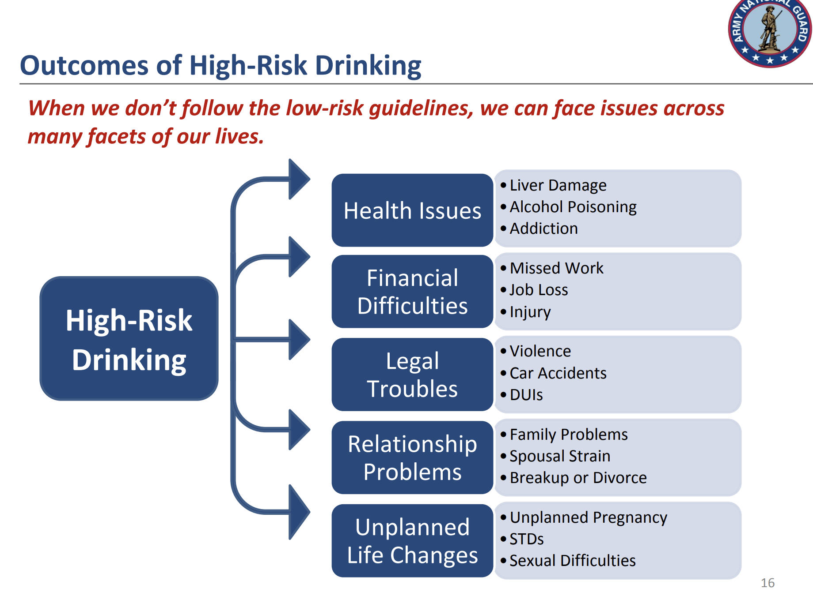

Slide 9
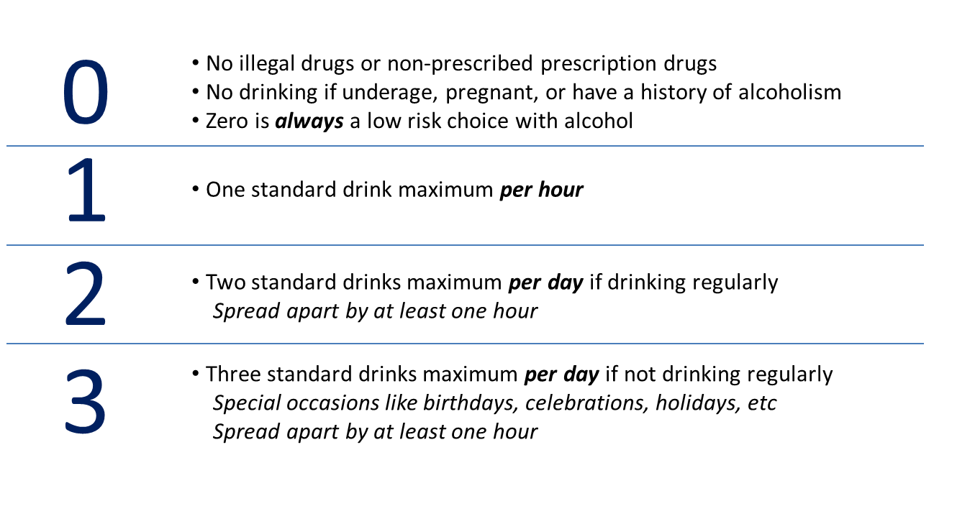
Drink with purpose
Low-Risk Guidelines help us to ensure we are making smarter choices when it comes to consuming alcohol.
So, what constitutes low-risk? It’s as simple as: 0 – 1 – 2 – 3
How can you help improve the drinking culture in your unit?
Notes:
These are the Low-Risk Guidelines, and they can help ensure we are making smarter choices when it comes to substance use and drinking alcohol.
The 0 stands for no use of illegal drugs, non-prescribed prescription drugs, underage drinking, drinking while you are pregnant, or have a history of alcoholism. 0 is always a low-risk choice.
1 stands for only having 1 standard drink in a 60-minute time period.
2 stands for 2 standard drinks per day for "regular" drinkers. "Regular" means you consume alcoholic beverages 4 or more days per week.
3 stand for 3 standard drinks per day in any 24-hour period.
These are not regulations, but guidelines to help avoid or mitigate risky behaviors, such as binge drinking or drinking and driving.
Binge drinking can have even more harmful effects than just having 1 or 2 per day. When we binge drink, we inundate our bodies with harmful substances and can cause even more damage to our brains and bodies. So, if you were thinking about “saving up” your 2 or 3 drinks a day and using them all on the weekend, think again. These are guidelines for everyone, regardless of your age, gender, size, or "tolerance". We will discuss the concept of "tolerance" in just a minute.
Intent: Teach and review 0-1-2-3 Low Risk Guidelines, reviewing each part in detail.

Slide 10
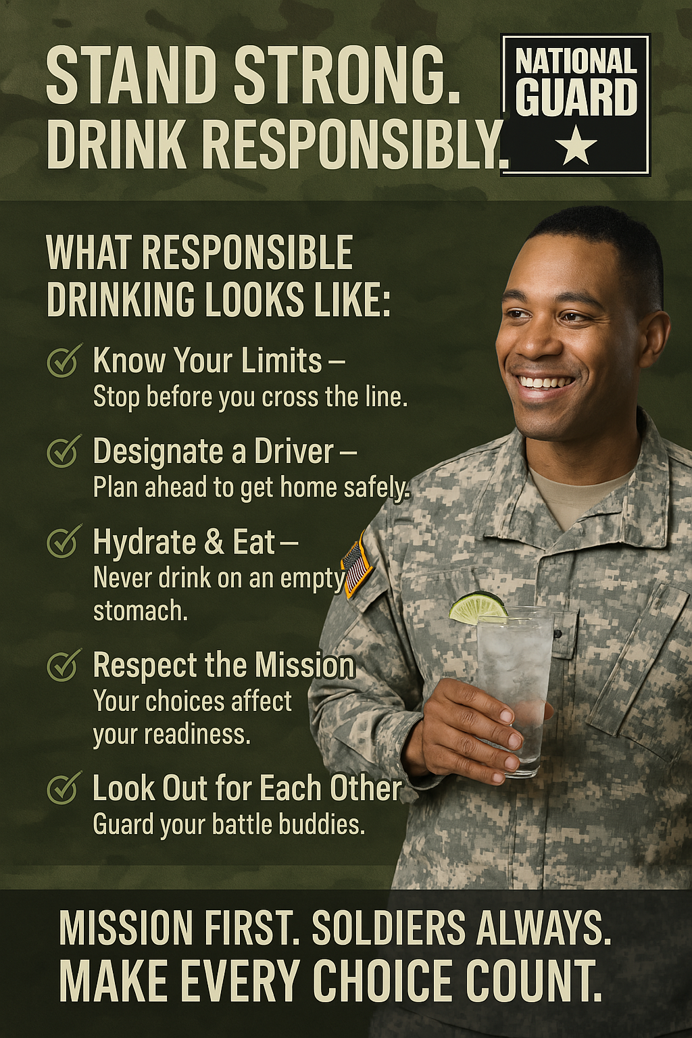
Decide beforehand: When will you drink? How much will you drink?

Slide 11
Financial readiness
Pays bills on time
Emergency savings
Responsible credit use
Maintain good habits
Continue budgeting tools
Contribute to savings and TSP
Occasionally late on bills
Credit for basic expenses
Limited savings
Review budget & spending
Seek free counseling
Explore debt reduction
Misses payments
Payday loans
Overwhelmed and avoidant
Seek help from certified financial counselor
Realistic debt management plan
Budgeting Apps ArmyResilience.army.mil/Financial-Readiness
Trent Scott, J9 Financial Advisor MilitaryOneSource.mil/Financial-Legal
Notes:
Acknowledge financial challenges, most of us are likely in yellow, and that’s ok. Just addressing our financial needs is progress.

Slide 12
Personal resiliency
High life satisfaction
Connection, hobbies, growth
Time to rest and reset
Set meaningful goals
Share appreciation
Good boundaries
Feels disconnected
Lack of enjoyment
Lack of self-care
Talk to a mentor
Schedule time to rest
Seek out training/opportunities
Dissatisfied/numb
Feels lack of meaning
Signs of burnout/despair
Talk to behavioral health or chaplain
Weekly talk with trusted friend
Wellness apps Master Resilience Training
Chaplain ArmyResilience.army.mil/ard/r2/armyfit.html
Notes:
Acknowledge financial challenges, most of us are likely in yellow, and that’s ok. Just addressing our financial needs is progress.

Slide 13
sleep readiness
7-9 hours sleep nightly
Consistent wake/bedtime
Feels rested
Maintain routine
Protect sleep environment
Continue good habits
5-6 hours of sleep
Irregular sleep/sleepiness
Reliance on caffeine
Limit caffeine/screentime
Practice relaxation
Adjust sleep habits
<5 hours of sleep nightly
Insomnia
Difficulty staying alert
Consult medical/BH
Avoid alcohol/late night meals
Sleep tracking tools
Sleep Apps FM 7-22, 11-7
H2F facilitator WRAIR.health.mil/Sleep-Resources
Notes:
One of the most common risk factors we see is trouble sleeping, which makes everything harder

Slide 14
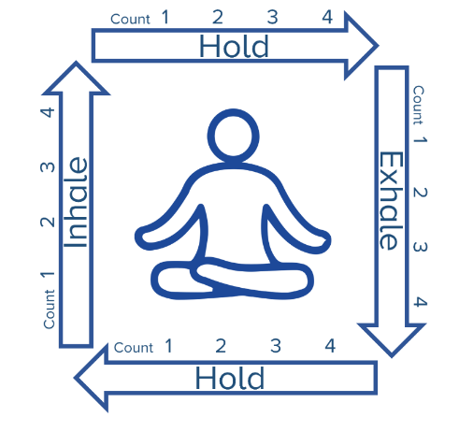
Emotional readiness (abuse prevention)
Mutual respect/trust
Honest communication
Healthy conflict resolution
EQ and listening skills
Healthy boundaries
Shared goals/celebration
Arguments/stonewalling
Disrespect
Controlling behavior
Discuss boundaries
Chaplain/counseling support
Stress relief techniques
Verbal insults
Physical aggression
Intimidation/manipulation
Behavioral Health
Safety plan
Commander intervention
MFLC: 801-716-9228
DPH: 801-716-9068
Notes:
MFLC: Military Family Life Counselors: DPH: Directors of Psychological Health. Example of square breathing to regulate emotions.

Slide 15
Unit cohesion
Trust/open communication
Feel respected and valued
Strong collaboration
Transparent communication
Recognition of contributions
Climate of mutual respect and support
Limited trust
Feeling disconnected
Concerns not addressed
Cultivate relationships
Peer mentorship
Small group discussions
Do not feel safe/supported
Disrespect/harassment
Low morale/motivation
Engage leaders, BH, EO
Promote accountability/enforcement
J9 Resources https://www.armyresilience.army.mil/ard/R2/I-Want-to-Build-Chaplain Unit-Cohesion.html
Notes:
One of the most common risk factors we see is trouble sleeping, which makes everything harder

Slide 16
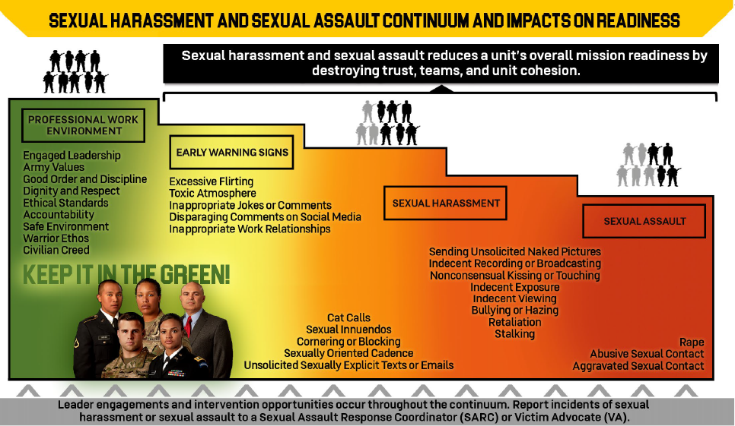
Sexual/relationship readiness
Sleep Apps FM 7-22, 11-7
H2F facilitator WRAIR.health.mil/Sleep-Resources
Chaplain; SAPRO: Andrew Kalinen; 801-716-9254
Notes:
One of the most common risk factors we see is trouble sleeping, which makes everything harder

Slide 17
Discipline/good conduct
Self-control and respect
Follows Army Values
No misconduct/legal issues
Recognize and reward behavior
Soldiers as peer role models
Occasional discipline issues/peer pressure
Inappropriate jokes/behavior off-duty
Team level discussion to reinforce standards
Corrective counseling/mentorship
Illegal activity
Substance use
Disregards values/orders
Corrective action
BH, legal, command teams
Development/monitoring plans
Unit leadership Behavioral Health /MFLC
JAG/TDS
Notes:
One of the most common risk factors we see is trouble sleeping, which makes everything harder

Slide 18
Army environment
Career satisfaction
Strong motivation
Feels pride, purpose, connection
Recognize achievements and good examples
Support career planning & mentorship
Frustration and disconnect
Lack of engagement
Poor fit/role
Goals and mentorship
Address barriers to satisfaction
Unhappy with military
Undervalued/unrecognized
Isolation
Active listening/validation
Career counselors/BH
Unit recognition programs
Unit leaders Retention
Chaplain J9 resources
Notes:
One of the most common risk factors we see is trouble sleeping, which makes everything harder

Slide 19
Readiness and resilience
YOU’VE GOT THIS
Self-Awareness
Growth Mindset
Healthy Habits
WE’VE GOT YOU
Unit Support
State Support
Army Support

Slide 20

Individual: Self-Awareness

Slide 21
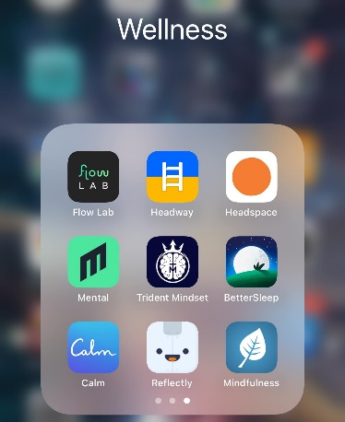
Individual: growth mindset
The answer to everything
Compassionate
Curious
Acceptance
Clear
Gentle
Firm
Everything is information
Everything is invitation

Slide 22

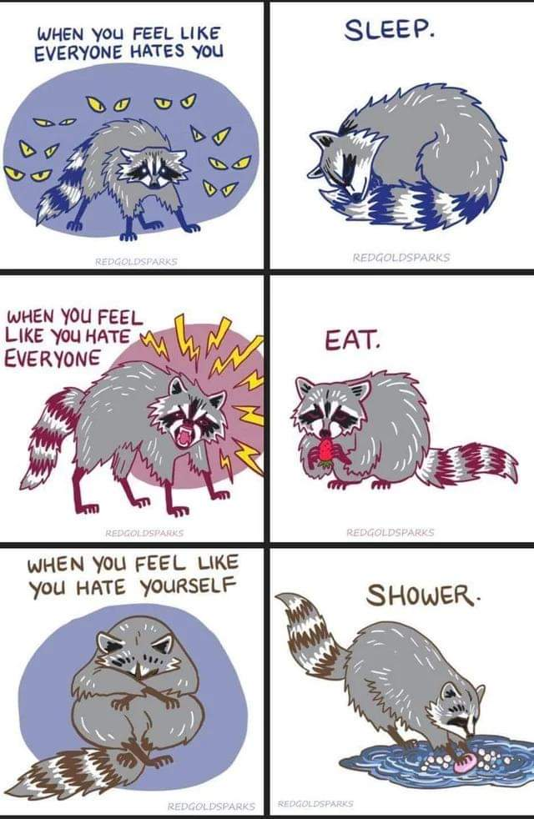
Individual: healthy habits

Slide 23
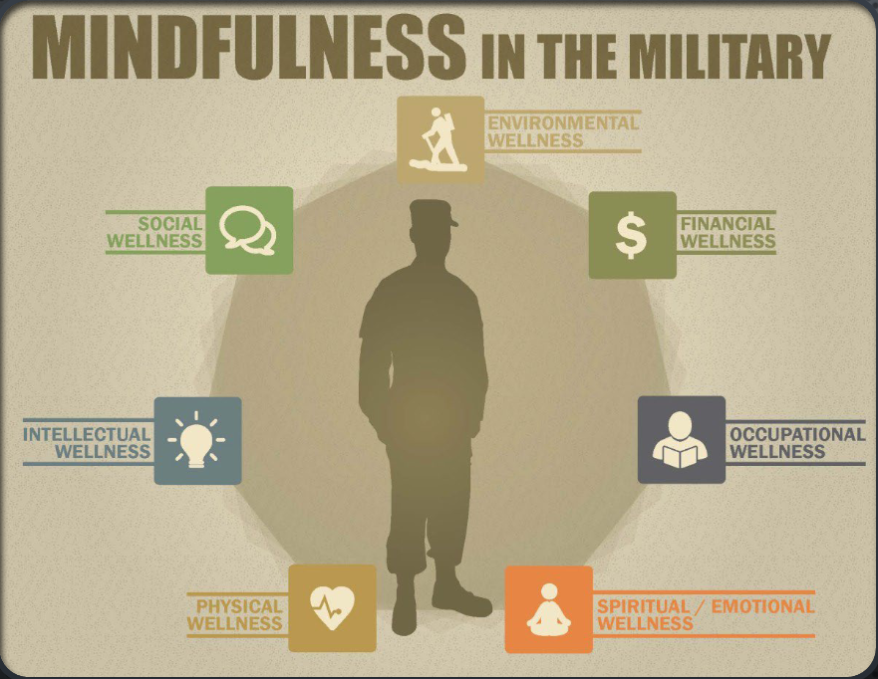
Good enough resilience
Good enough moment
  Calm the body
  Clear the mind
Good enough day
Good enough week
  Sustainable wellness
Good enough life
  Purpose, values, relationship

Slide 24

for this section: how would you apply these principles to your own life?
How would you help your soldiers apply these principles?

Slide 25
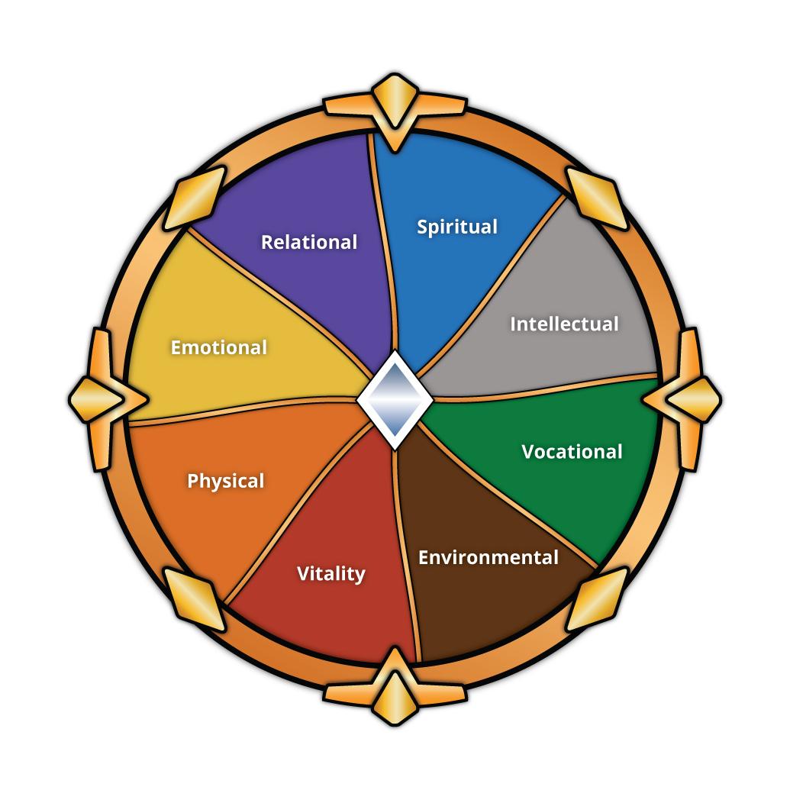
good enough wellness
Good enough life
Good enough week
Good enough moments
Good enough day

Slide 26
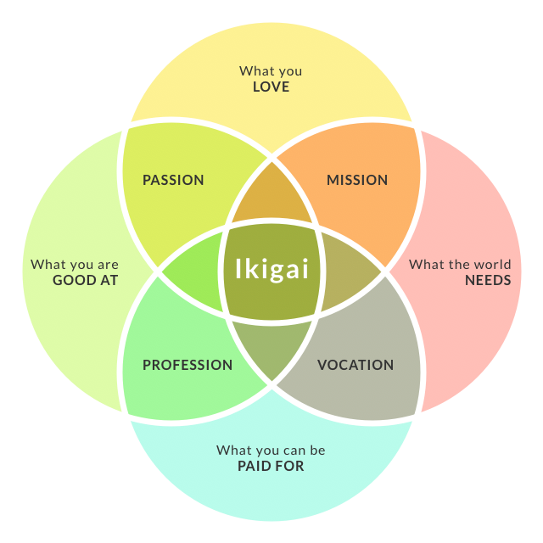

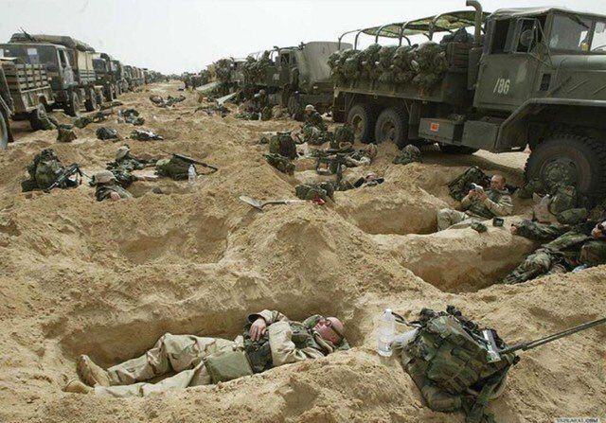
good enough life
Dreams and discernment
Find your fit
Pad your rock bottom

Slide 27

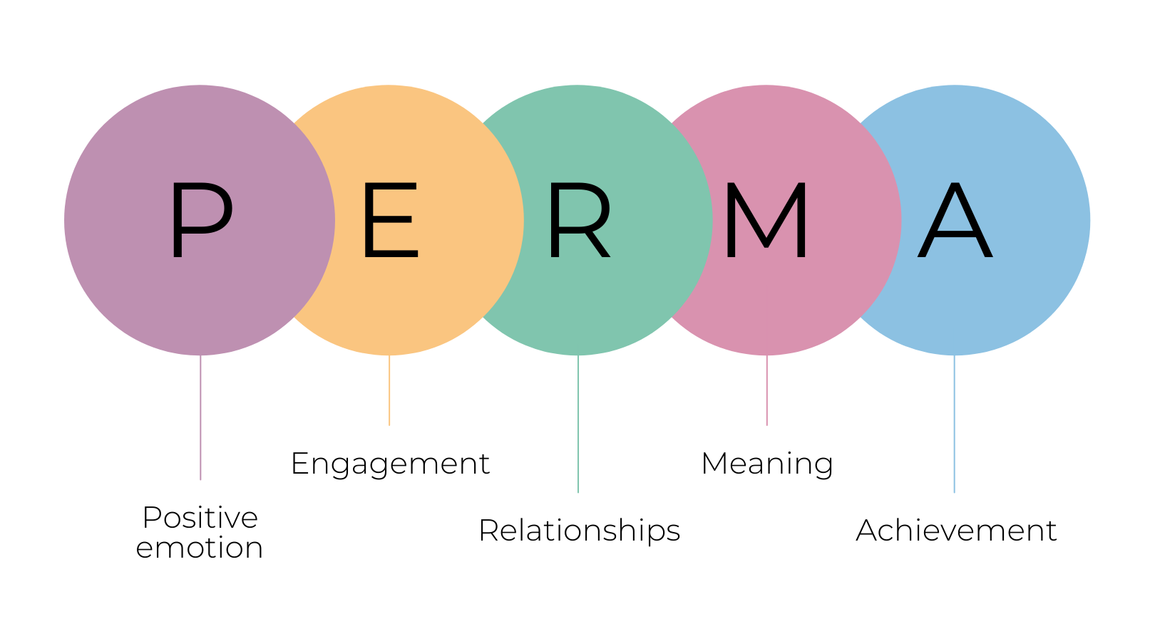
good enough week
Work-Life Sustainability
Relationships
Rest and recovery
Hobbies
Training
Goals
Yoda says, master before quitting

Slide 28
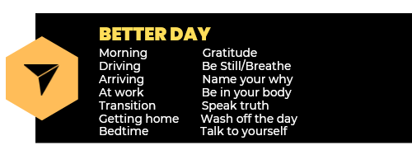
Individual: healthy habits
Minimum Sustainable Practice
What’s the least you can do?
  To be ok?
  To be better?

Slide 29

Unit support
Leadership
Suicide Intervention Officer
Master Resilience Trainer
Chaplain
Behavioral Health Officer
What does “Unit Culture” mean and how do you improve it?

Slide 30

Army Support
Military OneSource
GiveAnHour/Military

Slide 31

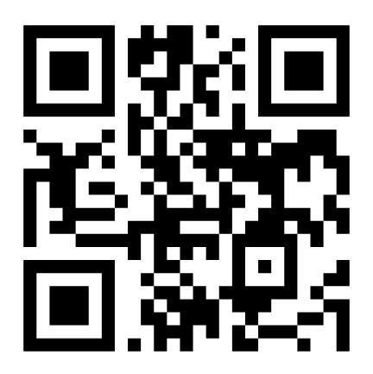
Train to the level of your life

