Slide 1


Risk Mitigation training
Readiness and resilience

Slide 2



Risk Reduction program
Risk Reduction Coordinator
Chaplain
Jared Anderson
385-988-6288
jared.w.anderson4.mil@army.mil
Prevention Coordinator
Chaplain
Jeff Handy
801-855-6205
jeffrey.d.handy3.mil@army.mil
Prevention Coordinator
Darren Pain
385-202-9697
darren.g.pain.ctr@army.mil
https://guard.utah.gov/j9/#risk-reduction

Slide 3
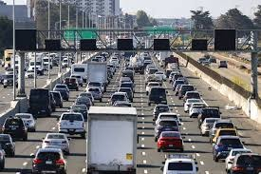


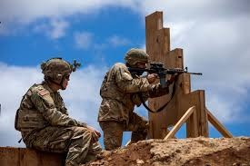


What is risk?
Necessary Risk
Optional Risk
Unnecessary Risk

Slide 4
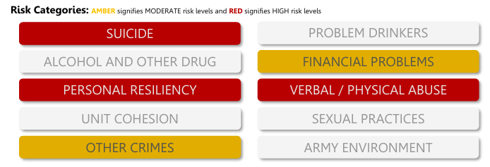
Risk Factors

Slide 5

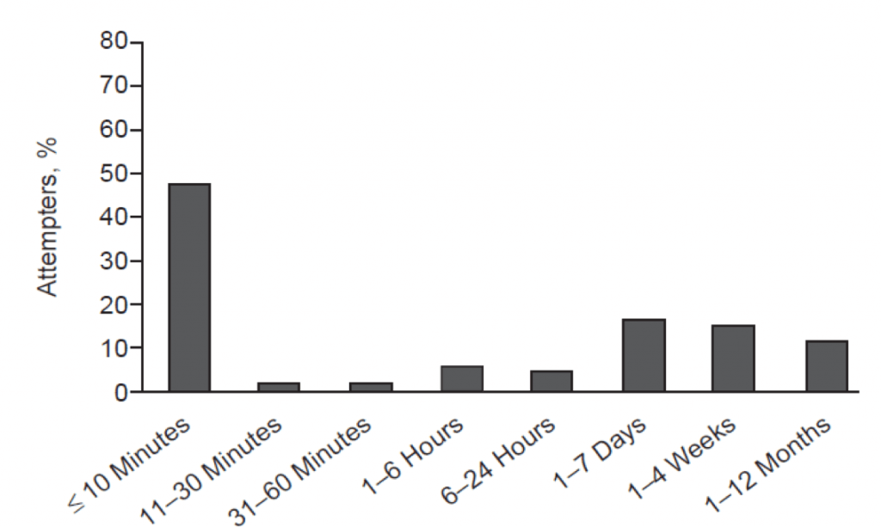
Scope of suicidal impulse
71%
< one hour
Notes:
As you apply ACE-SI, one of the most important things to remember is that active suicidal impulse is usually very brief. We only need to hold on for a matter of minutes (Story of Cottonwood traffic saving a Soldier’s life)

Slide 6
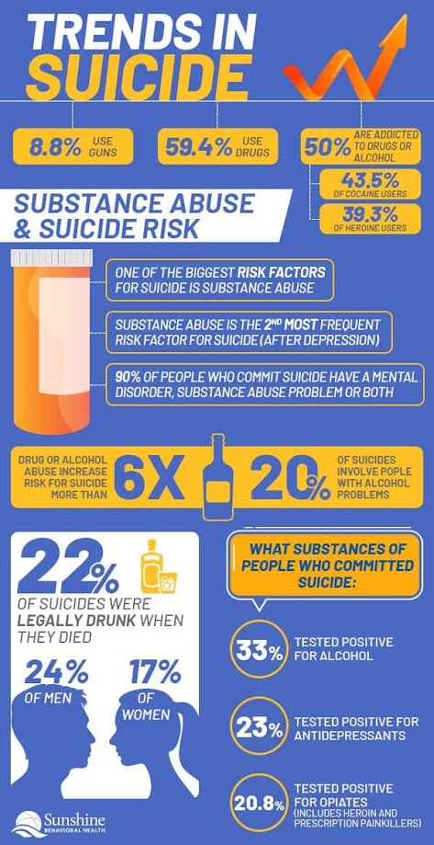

Senseless suicide
Notes:
What leads people to die by suicide can be tragically, stupidly simple. Alcohol and other substance abuse also dramatically increases the risk of suicide attempts.

Slide 7



Recognize the Signs to Assess Risks
WARNING SIGNS
  Time-sensitive concerns for suicide risk
  Stop and deal with this NOW
RISK FACTORS
  Issues that increase suicide risk
  Check in and follow up
PROTECTIVE FACTORS
  Behaviors or supports that reduce risk
  Encourage healthy behaviors
5
Notes:
Record your own notes here:
[NOTE: IAW ATP 5-19, managing risk is a process of identifying, assessing, and controlling risk arising from a recognized set of factors.]
5-A
ACE Unit Training- Base Module

Slide 8







Use ACE to Mitigate Risks
ASK if they are okay and if you can help
Show you CARE by listening to their problem
ESCORT them to an appropriate helping resource
Choose a risk factor. How could you use each step of ACE to help the Soldier mitigate the risk?
FACTORS
  Avoiding friends or isolating
  Dramatic mood changes
  Anger or irritability
  Anxiety or depression
  Inability to sleep
  Poor coping mechanisms
  Family/loved one’s history of suicide
  Bullying or discrimination
  Loss, conflict, change in relationships
  Job/financial problems
RISK
12
Notes:
12-A
ACE Unit Training- Base Module
[?]
Record your own notes here:

Slide 9

ASAP Program
Substance Abuse Program Initiation
  UA Positive
  Self Referral
  Commander Referral
Commander Counseling
Soldier contacts Psychological Health
ASAP team supports Soldier
Notes:
“The ASAP process starts one of four ways:
A positive urinalysis,
A self-referral, (Without Knowledge of a pending or ongoing drug test)
A commander’s referral, or
Counseling referral.
Once that happens, the ASAP team coordinates support—counseling, education, or treatment as needed.
The goal isn’t to kick soldiers out—it’s to restore them to duty and help them recover. Rehabilitation comes first whenever possible.
Remember, this is a readiness program, not a punishment program.”

Slide 10
Financial readiness
Pays bills on time
Emergency savings
Responsible credit use
Maintain good habits
Continue budgeting tools
Contribute to savings and TSP
Occasionally late on bills
Credit for basic expenses
Limited savings
Review budget & spending
Seek free counseling
Explore debt reduction
Misses payments
Payday loans
Overwhelmed and avoidant
Seek help from certified financial counselor
Realistic debt management plan
Budgeting Apps ArmyResilience.army.mil/Financial-Readiness
Trent Scott, J9 Financial Advisor MilitaryOneSource.mil/Financial-Legal
Notes:
Acknowledge financial challenges, most of us are likely in yellow, and that’s ok. Just addressing our financial needs is progress.

Slide 11
Personal resiliency
High life satisfaction
Connection, hobbies, growth
Time to rest and reset
Set meaningful goals
Share appreciation
Good boundaries
Feels disconnected
Lack of enjoyment
Lack of self-care
Talk to a mentor
Schedule time to rest
Seek out training/opportunities
Dissatisfied/numb
Feels lack of meaning
Signs of burnout/despair
Talk to behavioral health or chaplain
Weekly talk with trusted friend
Wellness apps Master Resilience Training
Chaplain ArmyResilience.army.mil/ard/r2/armyfit.html
Notes:
Acknowledge financial challenges, most of us are likely in yellow, and that’s ok. Just addressing our financial needs is progress.

Slide 12
sleep readiness
7-9 hours sleep nightly
Consistent wake/bedtime
Feels rested
Maintain routine
Protect sleep environment
Continue good habits
5-6 hours of sleep
Irregular sleep/sleepiness
Reliance on caffeine
Limit caffeine/screentime
Practice relaxation
Adjust sleep habits
<5 hours of sleep nightly
Insomnia
Difficulty staying alert
Consult medical/BH
Avoid alcohol/late night meals
Sleep tracking tools
Sleep Apps FM 7-22, 11-7
H2F facilitator WRAIR.health.mil/Sleep-Resources
Notes:
One of the most common risk factors we see is trouble sleeping, which makes everything harder

Slide 13
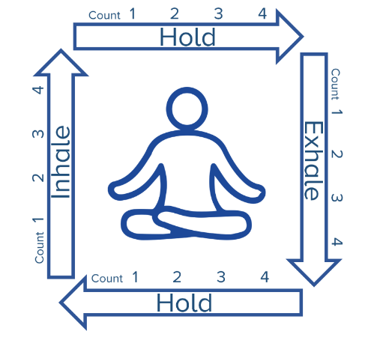
Emotional readiness (abuse prevention)
Mutual respect/trust
Honest communication
Healthy conflict resolution
EQ and listening skills
Healthy boundaries
Shared goals/celebration
Arguments/stonewalling
Disrespect
Controlling behavior
Discuss boundaries
Chaplain/counseling support
Stress relief techniques
Verbal insults
Physical aggression
Intimidation/manipulation
Behavioral Health
Safety plan
Commander intervention
MFLC: 801-716-9228
DPH: 801-716-9068
Notes:
MFLC: Military Family Life Counselors: DPH: Directors of Psychological Health. Example of square breathing to regulate emotions.

Slide 14
Unit cohesion
Trust/open communication
Feel respected and valued
Strong collaboration
Transparent communication
Recognition of contributions
Climate of mutual respect and support
Limited trust
Feeling disconnected
Concerns not addressed
Cultivate relationships
Peer mentorship
Small group discussions
Do not feel safe/supported
Disrespect/harassment
Low morale/motivation
Engage leaders, BH, EO
Promote accountability/enforcement
J9 Resources https://www.armyresilience.army.mil/ard/R2/I-Want-to-Build-Chaplain Unit-Cohesion.html
Notes:
One of the most common risk factors we see is trouble sleeping, which makes everything harder

Slide 15
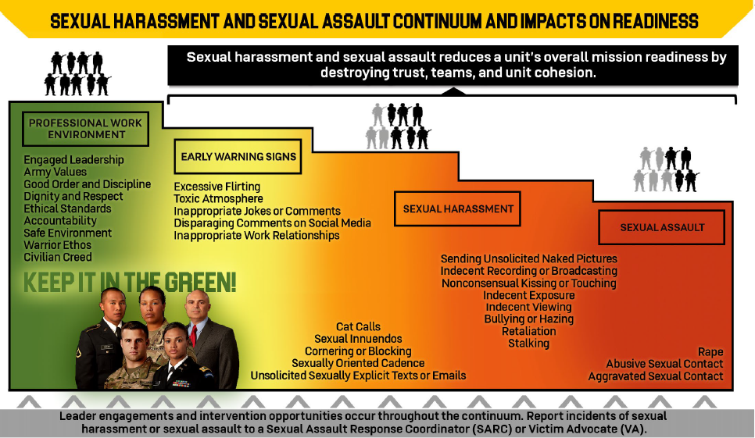
Sexual/relationship readiness
Sleep Apps FM 7-22, 11-7
H2F facilitator WRAIR.health.mil/Sleep-Resources
Chaplain; SAPRO: Andrew Kalinen; 801-716-9254
Notes:
One of the most common risk factors we see is trouble sleeping, which makes everything harder

Slide 16
Discipline/good conduct
Self-control and respect
Follows Army Values
No misconduct/legal issues
Recognize and reward behavior
Soldiers as peer role models
Occasional discipline issues/peer pressure
Inappropriate jokes/behavior off-duty
Team level discussion to reinforce standards
Corrective counseling/mentorship
Illegal activity
Substance use
Disregards values/orders
Corrective action
BH, legal, command teams
Development/monitoring plans
Unit leadership Behavioral Health /MFLC
JAG/TDS
Notes:
One of the most common risk factors we see is trouble sleeping, which makes everything harder

Slide 17
Army environment
Career satisfaction
Strong motivation
Feels pride, purpose, connection
Recognize achievements and good examples
Support career planning & mentorship
Frustration and disconnect
Lack of engagement
Poor fit/role
Goals and mentorship
Address barriers to satisfaction
Unhappy with military
Undervalued/unrecognized
Isolation
Active listening/validation
Career counselors/BH
Unit recognition programs
Unit leaders Retention
Chaplain J9 resources
Notes:
One of the most common risk factors we see is trouble sleeping, which makes everything harder

Slide 18
Readiness and resilience
YOU’VE GOT THIS
Self-Awareness
Growth Mindset
Healthy Habits
WE’VE GOT YOU
Unit Support
State Support
Army Support

Slide 19

Individual: Self-Awareness

Slide 20

Individual: growth mindset
The answer to everything
Compassionate
Curious
Acceptance
Clear
Gentle
Firm
Everything is information
Everything is invitation

Slide 21

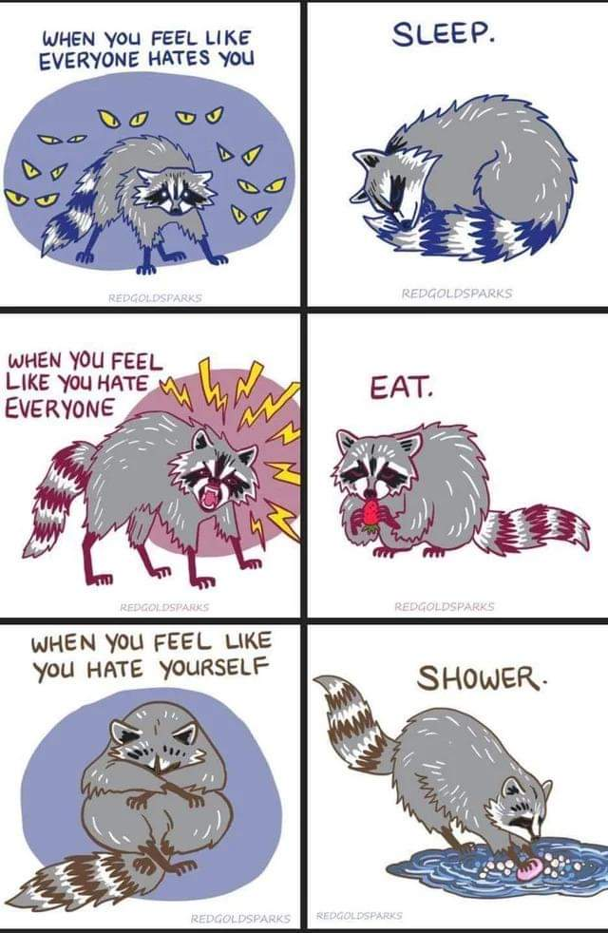
Individual: healthy habits

Slide 22

Good enough resilience
Good enough moment
  Calm the body
  Clear the mind
Good enough day
Good enough week
  Sustainable wellness
Good enough life
  Purpose, values, relationship

Slide 23

for this section: how would you apply these principles to your own life?
How would you help your soldiers apply these principles?

Slide 24
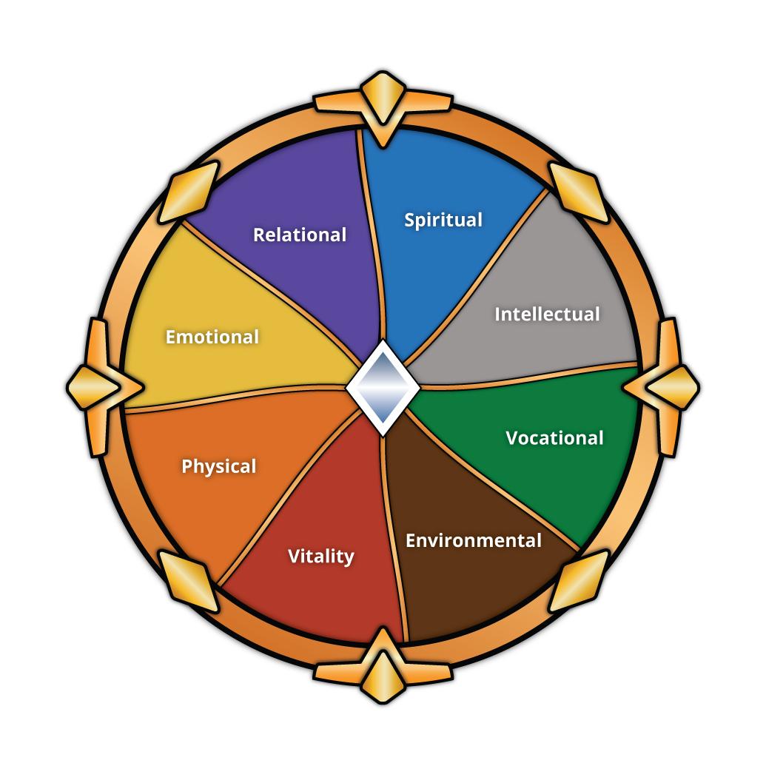
good enough wellness
Good enough life
Good enough week
Good enough moments
Good enough day

Slide 25
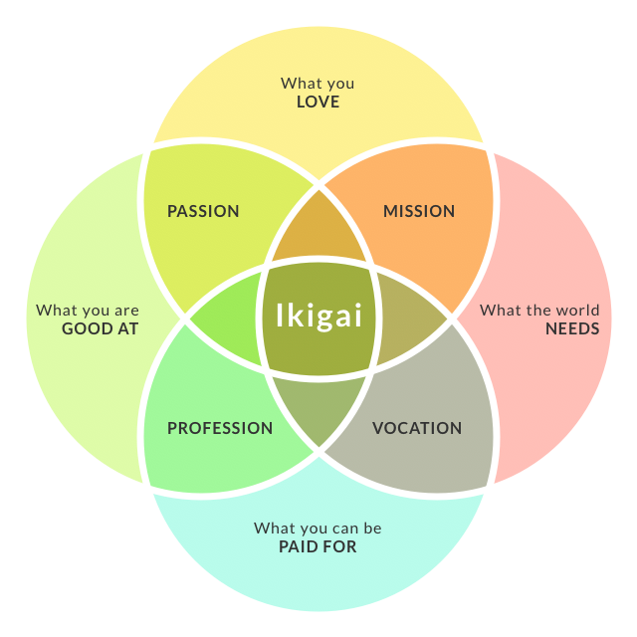

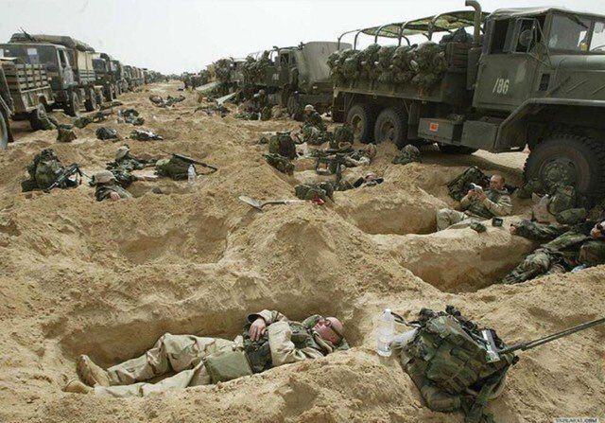
good enough life
Dreams and discernment
Find your fit
Pad your rock bottom

Slide 26

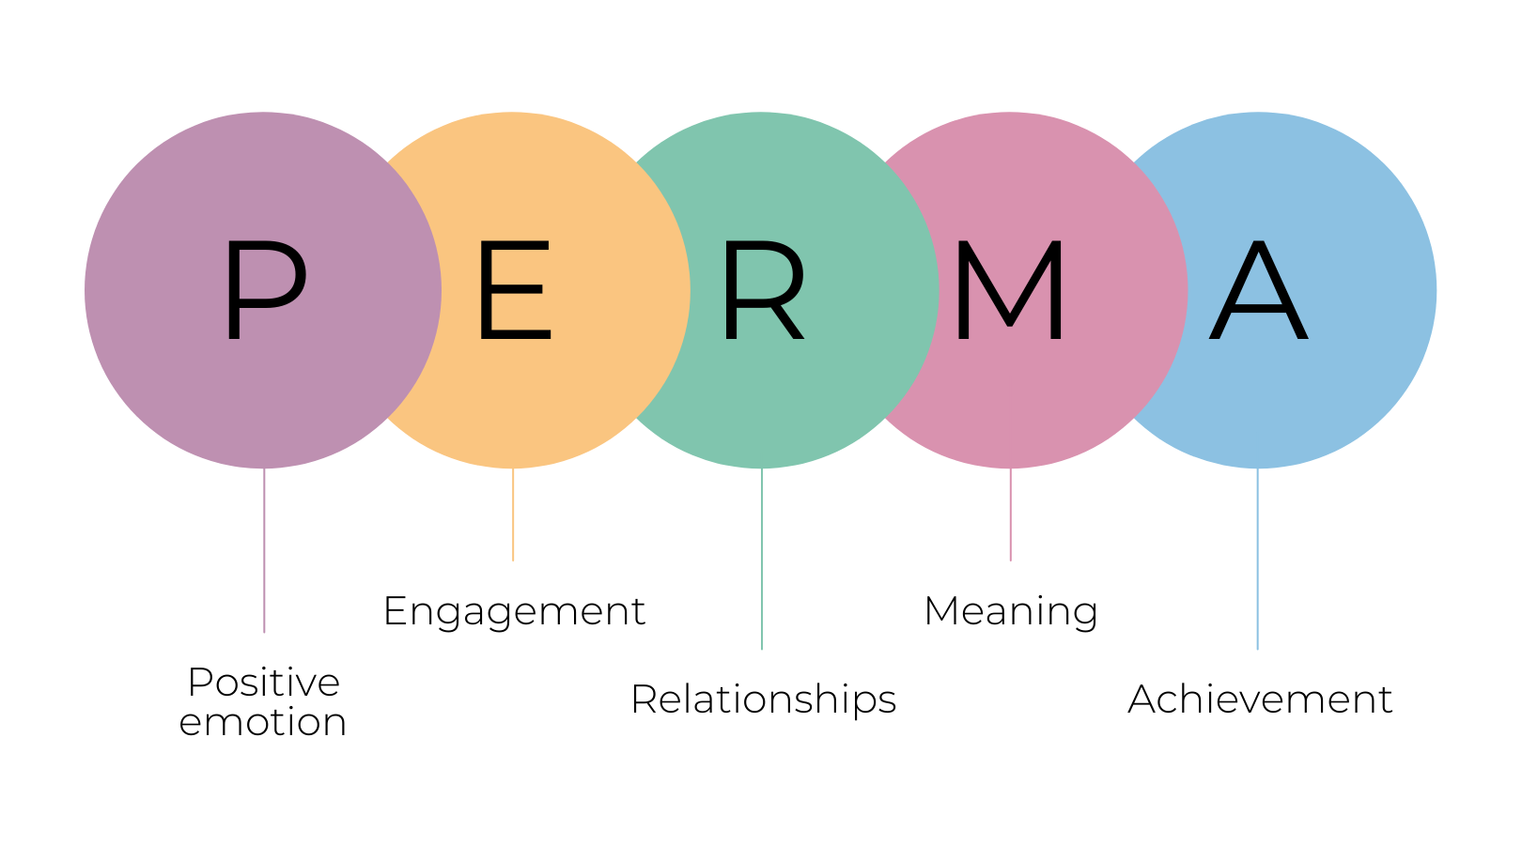
good enough week
Work-Life Sustainability
Relationships
Rest and recovery
Hobbies
Training
Goals
Yoda says, master before quitting

Slide 27
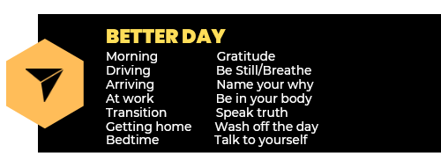
Individual: healthy habits
Minimum Sustainable Practice
What’s the least you can do?
  To be ok?
  To be better?

Slide 28

Unit support
Leadership
Suicide Intervention Officer
SFR (Soldier & Family Readiness)
Chaplain
Behavioral Health Officer
What does “Unit Culture” mean and how do you improve it?

Slide 29

Army Support
Military OneSource
GiveAnHour/Military

Slide 30

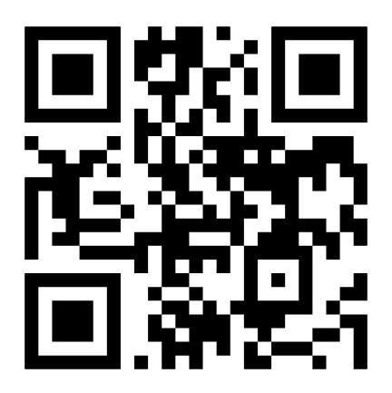
Train to the level of your life

