Slide 1
Army Equal Employment Opportunity (EEO), Anti-Harassment (AH), and Notification and Federal Employee Anti-Discrimination and Retaliation (No FEAR) Act Training for Non-Supervisors

Slide 2
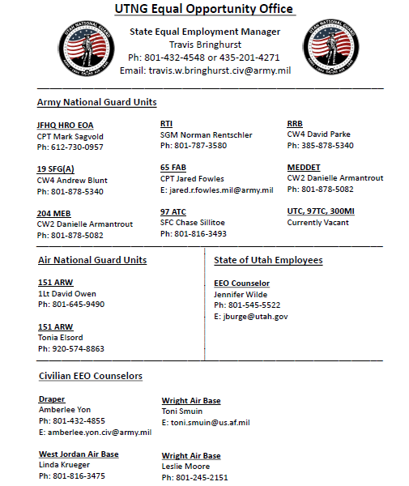
The UTNG MEO/EEO program is designed to maximize the military force potential by ensuring fair treatment without regard to race, color, sex, religion, national origin, age, or disability. We work to provide an environment free of unlawful discrimination, sexual harassment and offensive behavior. The UTNG MEO/EEO program promotes unit readiness, mission accomplishment, and unit effectiveness, by ensuring equal opportunity for every Soldier, Airman and Civilian through human relations education, diversity, organizational assessments, and fair treatment based on merit, accomplishments and capabilities.
State Equal Employment Manager:
Travis Bringhurst
801-432-4855
travis.w.bringhurst.civ@army.mil
Disability Program Manager:
Amberlee Yon
801-432-4855
amberlee.yon.civ@army.mil

Slide 3
Training Description
The training covers the No FEAR Act, Army Equal Employment Opportunity (EEO) Policy, the EEO Complaint Process, Reasonable Accommodations, Accessibility, Anti-Harassment Policy, Prohibited Personnel Practices, and Whistleblower Protection Laws. The training introduces employees to the forms of discrimination, the timeline for filing a discrimination or harassment complaint; examples of and the timeline for processing reasonable accommodations; types and effects of harassment; and the purpose and timeline for filing an action with the Office of Special Counsel or the Merit Systems Protection Board (MSPB).
Learning Objectives
Understand the No FEAR Act which protects employees from employment discrimination and retaliation.
Understand the types of discrimination covered under laws and Army policy.
Understand the protections provided to Army Civilians against retaliation and reprisal.
Understand the steps and timeline filing a complaint.
Define reasonable accommodation (RA) and Personal Assistance Services (PAS), the basis for providing RA and PAS, the confidentiality requirements, and the tenets of the RA and PAS process.
Understand examples of and the effects of harassment.
Understand the reporting process for complaints of Civilian Sexual Harassment and Non-Sexual Harassment.
Understand Prohibited Personnel Practices, Federal oversight, and reporting processes.
Understand Whistleblower protection, Federal oversight, and the reporting processes.
Understand the purpose and authority of the Merit Systems Protection Board and the requirements for filing a complaint or appeal.
Target Audience
Army Civilians in non-supervisory roles

Slide 4
The No FEAR Act

Slide 5
No FEAR Act
The No FEAR Act of 2002, as amended by the Elijah E. Cummings Federal Employee Antidiscrimination Act of 2020, provides robust protections for federal employees, former employees and applicants for employment under existing discrimination, whistleblower protection, and retaliation laws. See https://www.gsa.gov/portal/content/101344
The No FEAR Act requires that “…Federal agencies be accountable for violations of anti-discrimination and whistleblower protection laws” by:
Notifying employees and applicants for employment about their rights under the Federal anti-discrimination and whistleblower laws.
Providing training to their employees on the rights and remedies available under anti-discrimination and whistleblower laws.
Posting data on their public websites about EEO complaints filed, findings made, and outcomes.
Paying awards, judgments, and settlements from Federal lawsuits and the administrative complaint process involving discrimination and whistleblower retaliation from their own funds.
Annotating personnel records to note adverse action taken against employees determined to have committed an act of discrimination or retaliation.

Slide 6
Army EEO Policy and Procedures

Slide 7
Federal anti-discrimination laws protect employees from unlawful discrimination in the terms, conditions, and benefits of their employment. Some examples of these include:
Hiring
Promotion
Reassignments
Pay
Leave
Awards
Performance Evaluations
Training
Career Development Programs
Job Classification
Reprimands
Suspensions
Terminations

Slide 8
Retaliation and Reprisal
Retaliation
Federal agency officials may not fire, demote, harass, or otherwise “retaliate” against applicants or employees because they exercised their rights under any of the Federal antidiscrimination or whistleblower protections laws. https://www.opm.gov//equal-employment-opportunity/no-fear-act/#url=Notice
Reprisal
Discrimination based on reprisal occurs when management
treats employees differently because they are, or were,
involved in a protected EEO activity. Examples of protected activities include seeking or participating in EEO counseling, providing testimony in an EEO investigation or at an EEO
hearing, filing a discrimination complaint, speaking out
against perceived discriminatory act, or requesting or
receiving a reasonable accommodation.
Source (s): AR 690-12, “Equal Employment Opportunity and Diversity” and https://www.eeoc.gov/laws/guidance/retaliationreprisal-brochure

Slide 9
Equal Employment Opportunity Discrimination Bases
The Army is committed to developing and maintaining a professional workplace in which all individuals are treated with dignity and respect, and supervisors have a legitimate, non-discriminatory reason for every personnel action and employment decision. This includes ensuring an environment for Army civilian employees free from discrimination on any of the following bases, in all aspects of employment, in accordance with anti-discrimination laws:
Race to include personal characteristics associated with race such as hair texture, skin color, or certain facial features.
Color of skin or complexion.
Religion (for example, an employee cannot be forced to participate or not to participate in a religious activity as a condition of employment, and reasonable accommodations must be provided unless they result in undue burden on the organization).
Sex (including sexual orientation, pregnancy, childbirth, and medical conditions related to pregnancy or childbirth).
National origin (being from a particular country or part of the world, appearance of a certain ethnic background, having an accent)
Age (forty and over)
Disability
Genetic information (individual or family medical history or genetic tests; such information is not to be requested and supervisors should seek to avoid participating in conversations where genetic information might be revealed)
Reprisal or retaliation for opposing discrimination, participating in discrimination complaint activities, such as being a witness for another employee, or requesting or receiving a reasonable accommodation.
Association (association or relationship with a person of a protected group)
For more information, visit: https://www.eeoc.gov/discrimination-type

Slide 10
Reporting Alleged Discrimination
Employees seeking resolution of alleged unlawful discrimination, harassment or retaliation must contact the servicing EEO Officer:
Within 45 calendar days of the alleged discrimination,
Or of the date the employee first became aware of the alleged discrimination,
Or in the case of alleged ongoing discrimination, within 45 calendar days of the most recent incident of alleged discrimination.
Employees covered by a Collective Bargaining Agreement who choose to pursue a discrimination complaint under the administrative grievance process may not also pursue an EEO complaint on the same matter under Title VII law.
Employees alleging age discrimination are not required to pursue a complaint through the EEO administrative process. They also have the option of filing in Federal District Court.
If employee elects to proceed directly to Federal District Court, they must give the Equal Employment Opportunity Commission notice of intent to sue within 180 calendar days of the date of the alleged discrimination.
For procedures and time limits for initiating an EEO complaint see AR 690-600 or
visit: https://www.eeoc.gov/publications/federal-eeo-complaint-processing-procedures

Slide 11
EEO Complaint Process
The EEO Complaint Process was created to determine whether an alleged act(s) of discrimination occurred within the nine protected categories.
To initiate the EEO complaint process, an individual must first contact their EEO office within 45 calendar days of when the most recent incident occurred or when the individual first became aware of the alleged discriminatory practice or action.
The process begins with an informal “pre-complaint” stage. If the matter is not resolved, the notice of right to file a formal complaint (form DA 2590) is given after the final interview.
In order to file a formal complaint, the DA 2590 form needs to be signed and returned to the EEO office within 15 calendar days. Once returned and the EEO office accepts the DA 2590, the formal complaint process begins.
Alleged Act or Actions
45 days
EEO Counselor
Alternative Dispute
Resolution Process
30 days
90 days
Final Interview
15 days
Formal EEO
Complaint Filed
180 days
Investigation
completed
Hearing before
Administrative Judge
Final Army (Agency)
Decision
30 days to elect
Final Action
by Agency
Complainant Only
Appeal to Office of
Federal Operations
Civil Actions
*All days are considered calendar days, which includes weekends and holidays
See AR 690-600, “EEO Discrimination Complaints.”

Slide 12
Reasonable Accommodations

Slide 13
Reasonable Accommodations
In general, under the Rehabilitation Act, a reasonable accommodation (RA) is any change in the work
environment or in the way things are customarily done that enables a person with a disability to enjoy equal employment opportunities.
The three RA categories include:
1. Modification to the job application process
2. Modifications to the work environment, or to the manner or circumstances under
which the position held or desired, is customarily performed
3. Modifications that enable an employee with a disability to enjoy equal benefits
and privileges of employment as are enjoyed by similarly situated employees
without disabilities
The Pregnant Worker’s Fairness Act (PWFA), amends the
Rehabilitation Act by requiring employers to provide RA for a worker’s
known limitations related to pregnancy, childbirth, or related medical
conditions, regardless of whether the conditions qualify as disabilities, unless the
accommodation would impose an undue hardship on the employer’s operations.
The Civil Rights Act requires RA of an employee’s religious beliefs or practices, unless doing so would cause an undue hardship upon the Army. The RA is usually a modification/exception to a rule or policy or an adjustment to a work schedule that enables an employee to abide by sincerely held religious beliefs, and/or observe religious practices, without disrupting Army operations, compromising workplace safety, infringing the rights of others, or causing other undue hardships.

Slide 14
Reasonable Accommodations
Common types of accommodations include:
Modifying work schedules or supervisory methods
Granting breaks or providing leave
Changing how or when job duties are performed
Removing and/or substituting a marginal function
Moving to different office space
Providing telework beyond that provided by the collective bargaining agreement or workplace agreements
Making changes in workplace policies
Providing assistive technology (hardware and software), communications equipment or specially designed furniture
Providing a reader or sign language interpreter
Removing an architectural or physical barriers in office spaces or cafeteria, including reconfiguring workspaces
Providing accessible parking
Providing materials in alternative formats (e.g., Braille, large print)
Providing a reassignment to a vacant position for which the person is qualified (if the person cannot be accommodated in their current job).
Permitting the use of the individual’s service dog
Accommodation information is available at https://askjan.org/ and https://www.cap.mil/

Slide 15
Reasonable Accommodations and Personal Assistance Services
RA are provided to job applicants and to qualified employees due to disability, pregnancy, childbirth, medical conditions resulting from pregnancy or childbirth, or due to sincerely held religious beliefs, practices or observances, unless doing so would cause undue hardship.
Personal Assistance Services (PAS) apply to qualified individuals with severe disabilities who require assistance performing activities of daily living to enable them to be at work or participate in work-related travel. PAS do not include performing an individual’s job tasks and are not medical services such as administering shots/immunizations, checking blood pressure, etc.
The RA and PAS procedures are the same and begin with the employee or applicant or a third party representing the employee or applicant, informing the supervisor or other management official of the need for a modification in the work environment or in the way things are customarily done, because of a medical condition, pregnancy, childbirth or religious limitation.
RA and PAS requests must be promptly processed and failure to do so may result in a violation of the law. Decisions on requests must be made within 30 days or less of the initial date of request.

Slide 16
Reasonable Accommodations and Personal Assistance Services
Requests for RA and PAS, medical documentation, and all associated information are confidential, filed separate from other personnel information, and shared only with those who have a need to know.
For more information, contact the servicing EEO office, consult AR 690-12, and visit the following links/sites:
https://www.army.mil/armyequityandinclusion#org-civilian-equal-employment-opportunity
https://www.eeoc.gov/laws/guidance/enforcement-guidance-reasonable-accommodation-and-undue-hardship-under-ada
https://www.eeoc.gov/laws/guidance/questions-answers-federal-agencies-obligation-provide-personal-assistance-services
https://www.eeoc.gov/laws/guidance/what-you-should-know-workplace-religious-accommodation
https://askjan.org/
https://cap.mil/
AR 690-12

Slide 17
Harassment

Slide 18
Harassment
Army Anti-Harassment Policy for the Workplace
Workplace harassment based on race, color, religion, sex (including sexual orientation, pregnancy, childbirth, or a medical conditions related to pregnancy or childbirth), national origin, age (forty and over), disability, genetic information (individual or family medical history), reprisal or retaliation is not acceptable in either the military or civilian ranks, association (association or relationship with a person of a protected group).
Harassment includes, but is not limited to, any offensive conduct such as slurs, jokes or other verbal, nonverbal or physical conduct that has the purpose or effect of unreasonably interfering with an individual’s work performance or creating an intimidating, offensive, or hostile environment.
Even if a single utterance, joke or act does not rise to the level of actionable harassment under the law, such conduct is contrary to Army values.
*Source: https://www.eeoc.gov/harassment

Slide 19
Harassment
Examples of Harassment
Include but are not limited to:
Verbal Conduct that could include
Racial or sexual epithets
Foul language
Unwanted sexual flirtations
Ethnic jokes
Derogatory statements or slurs
Physical conduct that includes improper touching or sexual assault; or
Visual harassment that could include racially or sexually explicit or derogatory posters, cartoons or drawings, obscene gestures, or items such as a noose.
Effects of Harassment
Lower productivity and morale
Emotional, physical, and economic harm
Higher turnover; loss of talent
Higher costs for hiring and training
Potential liability for damages and attorney's fees
Embarrassment to the Army
Degrades the Army’s reputation and ability to attract top talent
Degrades mission readiness
Penalties for Harassment: Discipline up to and including termination from employment if harassment claim is substantiated, dependent on the severity of the harassment

Slide 20
Harassment
Sexual Harassment
Sexual harassment is a form of sex discrimination.
There are two formally defined types of sexual harassment: Quid pro quo and hostile environment.
Quid pro quo is a Latin phrase literally meaning “this for that”.
Hostile environment, to include the work environment, can occur when Soldiers or DA Civilians are subjected to offensive, unwanted and unsolicited comments, or conduct of a sexual nature.
Sexual harassment includes unwelcome sexual advances, requests for sexual favors and other verbal or physical conduct of a sexual nature when:
submission to such conduct is made either explicitly or implicitly a term or condition of a person's job, pay or career; or
submission to or rejection of such conduct by a person is used as a basis for career or employment decisions affecting that person; or
such conduct has the purpose or effect of unreasonably interfering with an individual's work performance or creates an intimidating, hostile or offensive working environment.

Slide 21
Harassment
Procedures for Reporting
Civilian Sexual Harassment and Non-Sexual Harassment
If a DA Civilian believes they have been subjected to sexual harassment, the individuals should:
Communicate to the alleged harasser, in a manner that is comfortable, that the behavior is unwelcome, and it must stop immediately.
Promptly notify his/her supervisor of the unwelcomed comments/conduct.
Contact their local EEO Office.
If the supervisor is the one making unwelcomed comments/conduct, the employee should notify the next higher supervisor or other management officials in the organization.
Once the supervisor or next higher supervisor has been made aware, an investigation should be initiated immediately.
If you believe you have been sexually harassed, you have the right to file an EEO complaint using the EEO complaint process.

Slide 22
Harassment
Online Misconduct
"Electronic Communications" is
The transfer of information (signs, text, images, sounds, or data) transmitted by computer, phone, or another electronic device.
Not limited to text messages, emails, chats, instant messaging, screen savers , blogs, social media sites, electronic device applications, and web/video conferencing.

Slide 23
Harassment
Online Misconduct
"Online Conduct" is the use of electronic communication in an official or personal capacity that is consistent with Army Values and standards of conduct.
"Online Misconduct" is the use of electronic communication to inflict harm; examples include, but are not limited to:
Harassment
Bullying
Hazing
Stalking
Discrimination
Retaliation, or any other types of misconduct that undermines dignity and respect.

Slide 24
Prohibited
Personnel Practices

Slide 25
Prohibited Personnel Practices
Federal law makes it illegal to discriminate or retaliate against Federal employees because of their marital status, political affiliation or activities, sexual orientation, and whistleblowing.
Employees who believe this type of discrimination or retaliation has occurred may file a complaint with the U.S. Office of Special Counsel or the Merit Systems Protection Board.

Slide 26
Prohibited Personnel Practices
The Office of Special Counsel (OSC) is an independent Federal agency that
investigates complaints of prohibited personnel practices other than those enforced by EEOC under the Civil Service Reform Act of 1978, including discrimination on the basis of:
marital status
political affiliation or activities
sexual orientation
whistleblower retaliation
conduct that does not adversely affect employee performance
For additional information on Prohibited Personnel Practices visit:
https://osc.gov/Services/Pages/PPP-WhoCanFile.aspx

Slide 27
Whistleblower Protections

Slide 28
Whistleblower Protections
A federal employee authorized to take, direct others to take, recommend or approve any personnel action may not retaliate against an employee for protected whistleblowing.
Whistleblowing is when an employee or applicant discloses information that he or she reasonably believes is evidence of:
A violation of a law, rule or regulation
Gross mismanagement
Gross waste of funds
Theft
Unethical or unjust behavior in the workplace
An abuse of authority, or
A substantial and specific danger to public health or safety
Disclosures may be made to superiors in the chain of supervision, Inspectors General (IG), Congress, law enforcement officials, agency ethics officials, or any other agency officials responsible for ensuring integrity and acting against malfeasance within the agency.
If disclosure is barred by law, or information is required by Executive Order to be kept secret in the interest of national defense or conduct of foreign affairs, then employees are only protected if disclosure is made to Office of Special Counsel (OSC), IG, or Agency designee. Improper disclosures of protected information may result in discipline and/or prosecution.

Slide 29
Whistleblower Protections
The Office of Special Counsel (OSC) also provides a secure channel through which employees may
make confidential disclosures (“whistleblowing”).
OSC evaluates the disclosures to determine whether there is a substantial likelihood that one of
the categories listed above has been disclosed. If such a determination is made, OSC has the authority to require the head of the agency to investigate the matter.
If you believe that you have been subjected to whistleblower
retaliation or other prohibited personnel practice you may
access the forms from the OSC website and either file your
complaint to OSC online or print the forms and submit by mail.
OSC requires the use of specific forms to file a complaint not
submitted via online form. These forms are available on the
OSC Web site below.
For more information visit: http://www.osc.gov
U.S. Office of Special Counsel, 1730 M Street NW, Suite 218,
Washington, DC 20036-4505; Telephone: 202-254-3600

Slide 30
Merit Systems
Protection Board

Slide 31
Merit Systems Protection Board
The Merit Systems Protection Board (MSPB) is an independent Federal agency established to protect Federal merit system principles against partisan political and other prohibited personnel practices and to protect Federal employees against abuses by management.
The MSPB has the authority (in part) to review and issue rulings on:
Appeals of personnel actions such as removals, suspensions of more than 14 days, furloughs, and demotions.
Appeals of administrative decisions affecting rights or benefits under the Civil Service Retirement System or the Federal Employees' Retirement System.
Complaints filed under the Whistleblower Protection Act, the Uniformed Services Employment and Reemployment Rights Act, and the Veterans Employment Opportunities Act, and
Cases brought by OSC.

Slide 32
Merit Systems Protection Board
If you believe that a personnel action of the type that are appealable to the
MSPB has been taken on the basis of your race, color, religion, sex (including sexual orientation, pregnancy, childbirth, or a medical conditions related to pregnancy or childbirth), national origin, age (forty and over), disability, genetic information (individual or family medical history), or in retaliation for opposing such discrimination or participating in the discrimination complaint process you may choose to file an EEO complaint, or to file an appeal with the MSPB, but not both.
The appeal must be filed with the MSPB within 30 days of the effective date
of the personnel action.
For more information regarding procedures for filing MSPB appeals visit: https://www.mspb.gov.

Slide 33
Congratulations!
You have completed the Army EEO, Anti-Harassment and No FEAR
Training
for Non-Supervisors.
If you have questions, contact your local EEO representative.
If you have feedback or suggestions about this material, please email them to: usarmy.pentagon.hqda-asa-mra.mbx.EEOPP-helpdesk@army.mil.

Slide 34
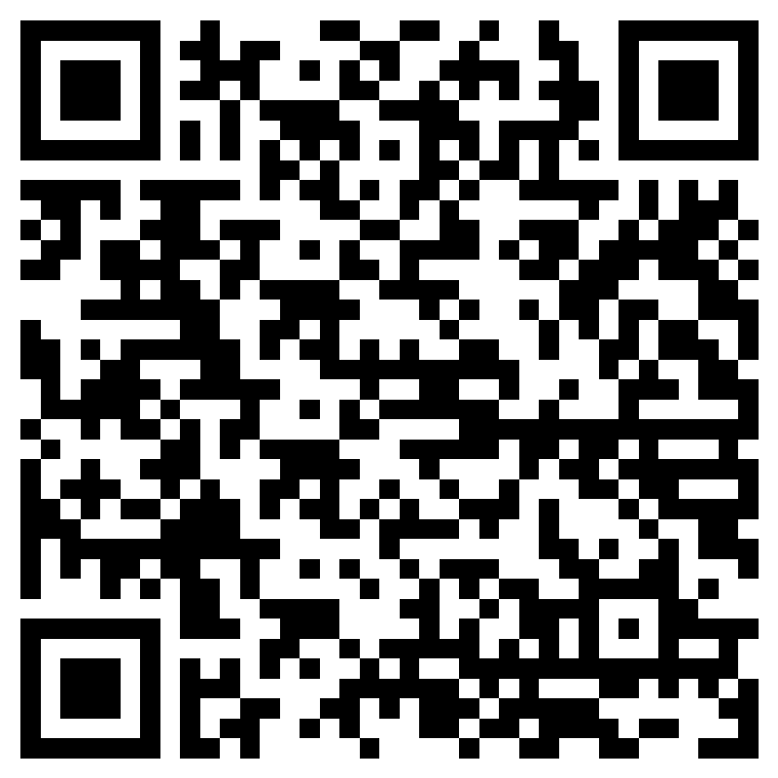
Verification of Completion

