Slide 1


Readiness and resilience
Notes:
Let’s start by talking about readiness and resilience. These two words are the backbone of everything we do.
Readiness is more than physical fitness—it’s mental, emotional, and behavioral preparedness. You can have the best equipment in the world, but if your mind and habits aren’t right, your readiness suffers.
Resilience means being able to bounce back when life hits hard. We all deal with stress—deployments, family issues, work demands etc.
What separates those who thrive from those who struggle is the ability to recover, to adapt, and to reach out for help early. Programs like ASAP, Behavioral Health, and the Master Resilience Training program exist to build that foundation before a crisis ever happens.”

Slide 2







Relaxing and Recovery
Notes:
“When we talk about recovery, we don’t just mean sleep or time off. We mean intentional recovery—choosing activities that actually possess restore you instead of drain you.
Ask yourself: how do you relax? For some people, it’s working out, fishing, music, or just being around family. The key is finding what truly resets you. Sometimes, soldiers think recovery means ‘I’ll have a few drinks,’ but alcohol doesn’t actually help your body recover—it delays it.
So, think about this: what are your recovery habits? Are they helping your readiness, or hurting it?”

Slide 3

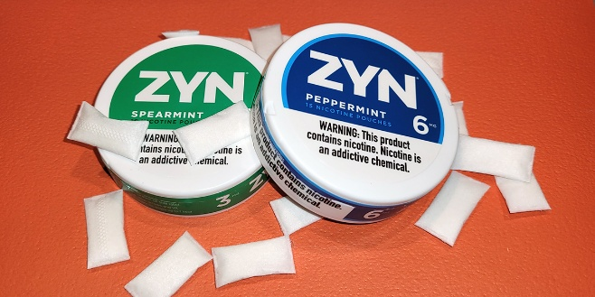



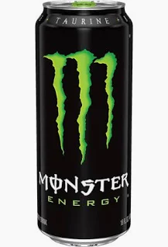
A weekend without…
Notes:
“Here’s a challenge I like to give: Can you go a weekend without one of your usual habits—whether that’s alcohol, social media, gaming, or energy drinks?
The point isn’t punishment—it’s awareness. You start to realize how often we rely on certain things to cope or to fill time.
Sometimes the hardest part isn’t the weekend—it’s realizing how automatic our habits have become. Try it once. You might find you feel better, sleep deeper, or save money without even planning to.”

Slide 4




What is your relationship to…

Slide 5

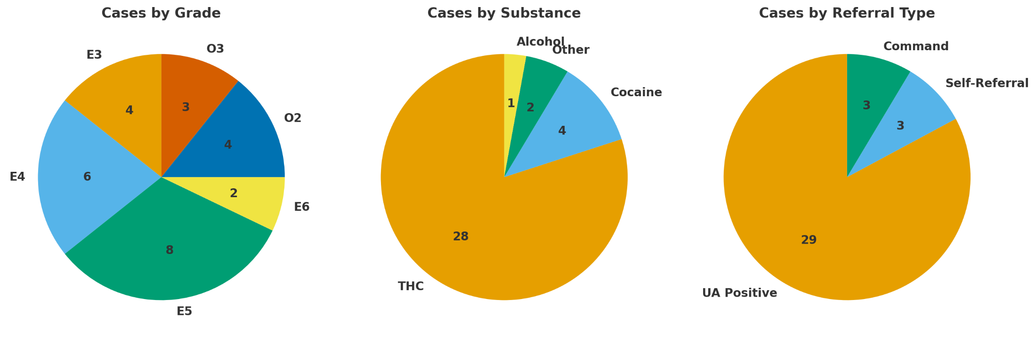
Lessons learned: substance abuse
Substance Abuse (35 cases in the last 12 months)
Risk Mitigation
ASAP training
Leadership training
Gaps
Alcohol usually not tracked
Low command referrals
Low self-referrals

Slide 6

ASAP Program
Substance Abuse Program Initiation
  UA Positive
  Self Referral
  Commander Referral
Commander Counseling
Soldier contacts Psychological Health
ASAP team supports Soldier
Notes:
“The ASAP process starts one of four ways:
A positive urinalysis,
A self-referral, (Without Knowledge of a pending or ongoing drug test)
A commander’s referral, or
Counseling referral.
Once that happens, the ASAP team coordinates support—counseling, education, or treatment as needed.
The goal isn’t to kick soldiers out—it’s to restore them to duty and help them recover. Rehabilitation comes first whenever possible.
Remember, this is a readiness program, not a punishment program.”

Slide 7
The limited use policy
Qualifications (AR 600-85):
A soldier must meet the following qualifications in order to be covered by the Limited Use Policy:
Voluntarily self-refer to their Commander, a military Chaplain, the SAP office or an NCO or officer in their Chain of Command.
    If the Soldier self-refers to their Chaplain, they must allow the Chaplain to inform Command in order for the Limited Use Policy to apply.
The Soldier must not have knowledge of a pending urinalysis or alcohol test.
The Soldier must provide the Commander with the facts and circumstances of drug and/ or alcohol use.
    When providing the Commander with the facts and circumstances of drug use, the Soldier must self-refer to all drugs they used.
    ***See complete policy for a more comprehensive understanding of the Limited Use Policy or call your RRC
Notes:
“The ASAP process starts one of four ways:
A positive urinalysis,
A self-referral, (Without Knowledge of a pending or ongoing drug test)
A commander’s referral, or
Counseling referral.
Once that happens, the ASAP team coordinates support—counseling, education, or treatment as needed.
The goal isn’t to kick soldiers out—it’s to restore them to duty and help them recover. Rehabilitation comes first whenever possible.
Remember, this is a readiness program, not a punishment program.”

Slide 8
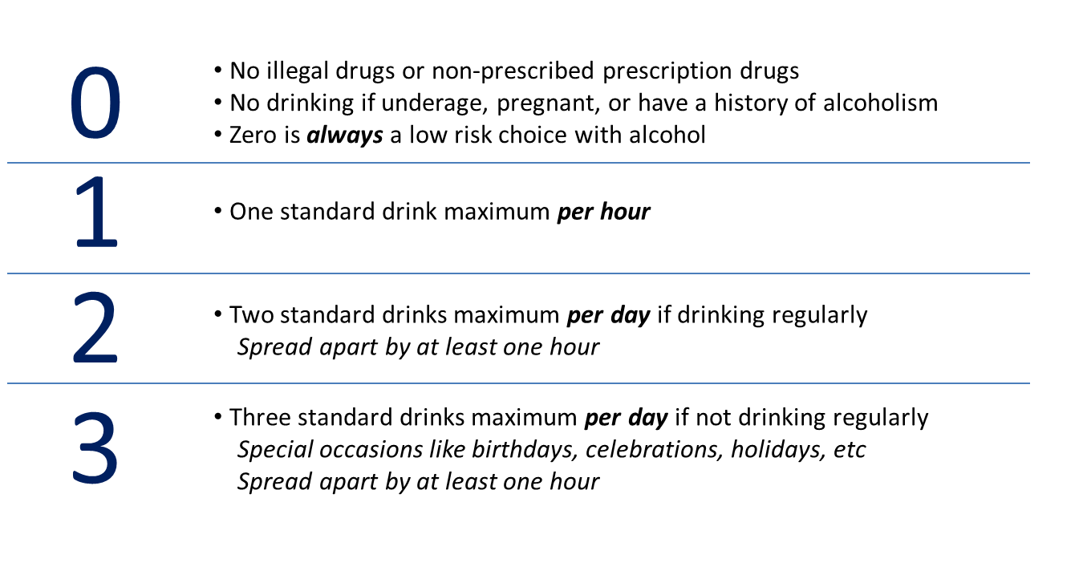
Low Risk drinking
Low-Risk Guidelines help us to ensure we are making smarter choices when it comes to consuming alcohol.
So, what constitutes low-risk? It’s as simple as: 0 – 1 – 2 – 3
Notes:
These are the Low-Risk Guidelines, and they can help ensure we are making smarter choices when it comes to substance use and drinking alcohol.
The 0 stands for no use of illegal drugs, non-prescribed prescription drugs, underage drinking, drinking while you are pregnant, or have a history of alcoholism. 0 is always a low-risk choice.
1 stands for only having 1 standard drink in a 60-minute time period.
2 stands for 2 standard drinks per day for "regular" drinkers. "Regular" means you consume alcoholic beverages 4 or more days per week.
3 stand for 3 standard drinks per day in any 24-hour period.
These are not regulations, but guidelines to help avoid or mitigate risky behaviors, such as binge drinking or drinking and driving.
Binge drinking can have even more harmful effects than just having 1 or 2 per day. When we binge drink, we inundate our bodies with harmful substances and can cause even more damage to our brains and bodies. So, if you were thinking about “saving up” your 2 or 3 drinks a day and using them all on the weekend, think again. These are guidelines for everyone, regardless of your age, gender, size, or "tolerance". We will discuss the concept of "tolerance" in just a minute.
Intent: Teach and review 0-1-2-3 Low Risk Guidelines, reviewing each part in detail.

Slide 9
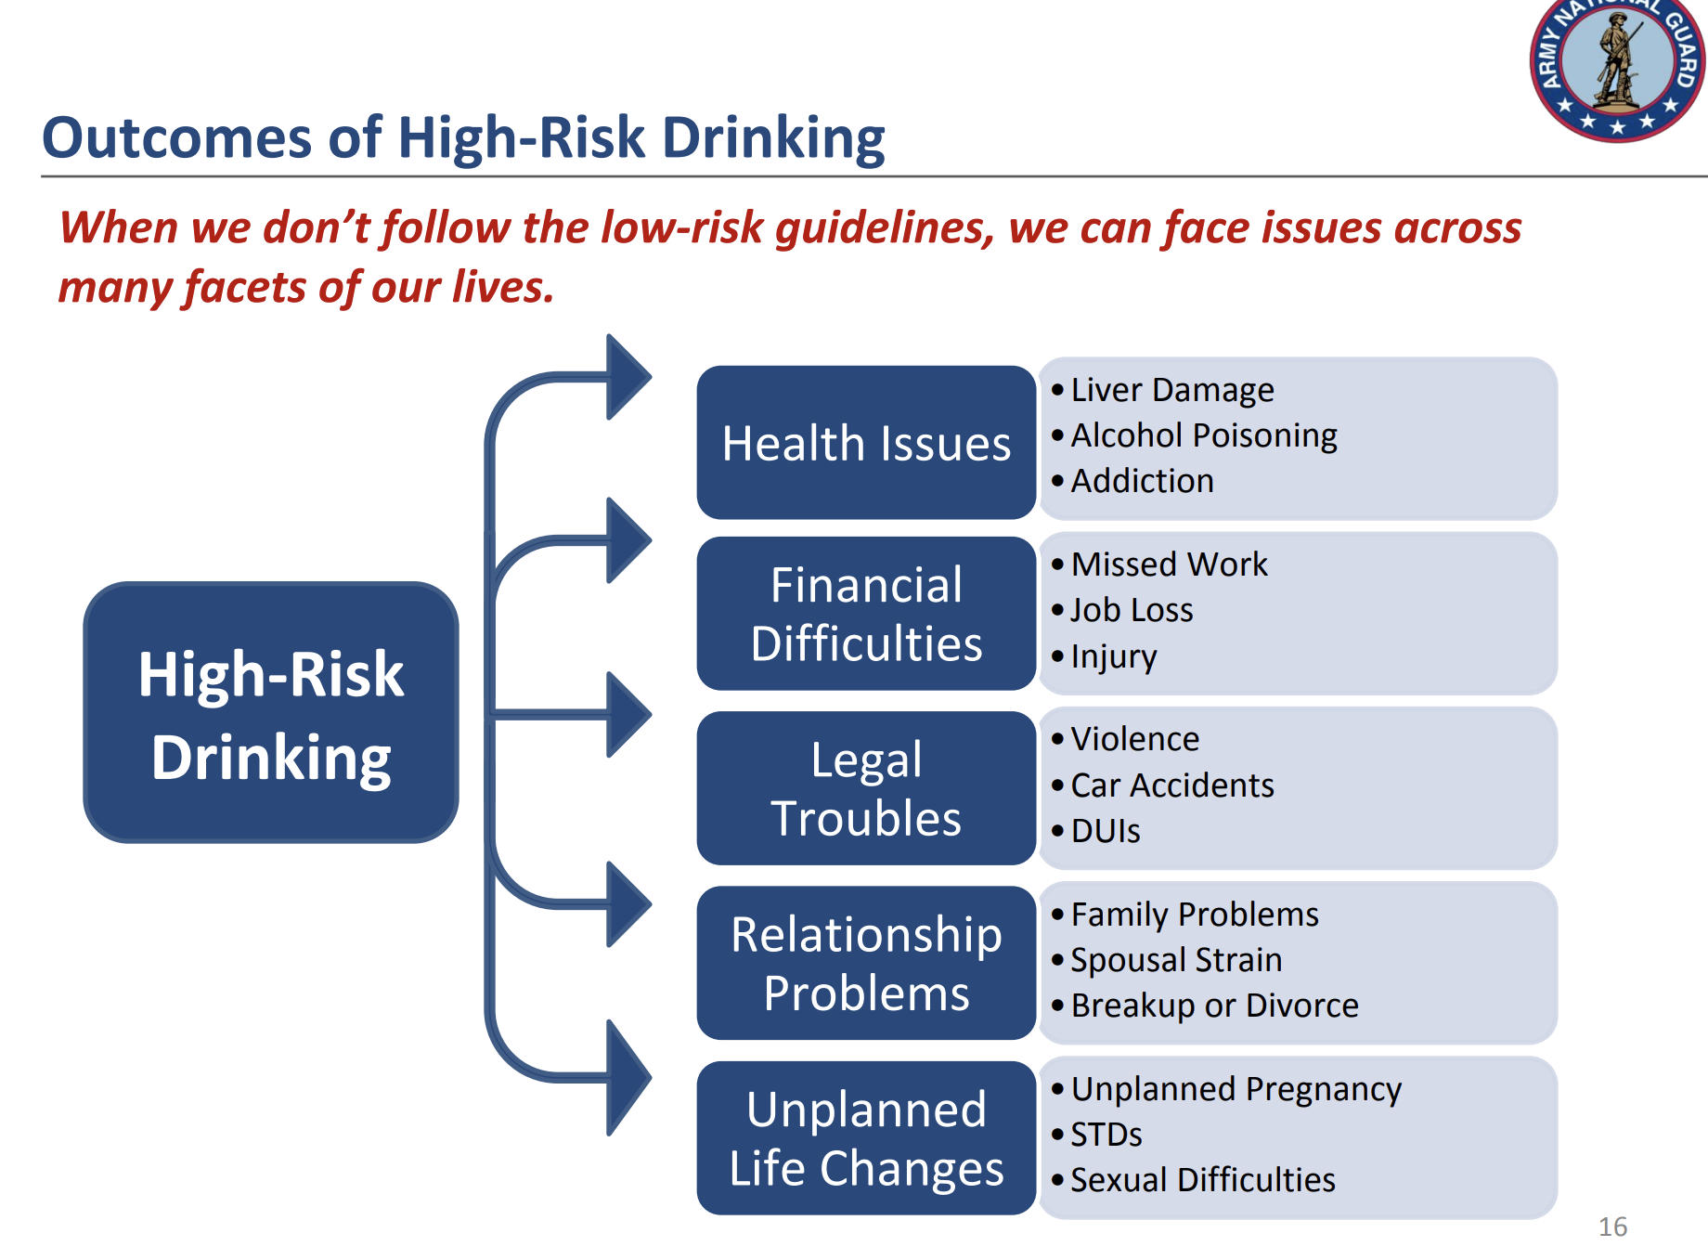
Outcomes of High-Risk Drinking
Notes:
“When we ignore low-risk drinking guidelines, it affects every area of our lives.”
Health Issues: Liver damage, addiction, alcohol poisoning.
Financial Problems: Missed work, injury, job loss, costly mistakes.
Legal Troubles: DUIs, violence, accidents — one bad choice can end a career.
Relationship Problems: Family conflict, spousal strain, breakups.
Unplanned Life Changes: Risky decisions leading to pregnancy, STDs, or regret.
“The bottom line — high-risk drinking doesn’t just hurt readiness; it hurts your future. Stay in control by drinking responsibly.”

Slide 10
Mandatory Initiation of Separation
Unit must initiate the process and TAG makes final decision
AR 600-85, para 10-6
  2 serious alcohol related offenses within 12 months
    Serious incident - any civil or military offense that is punishable under the UCMJ by confinement for a term exceeding one-year
  Convicted of DUI/DWI a second time during a career
  Possession/sale of illegal drugs
  Illegal drug abuser by a verified positive test
18 USC 922(g)(3) – Possession of Firearms
NGB Memorandum – 4 AUG 20
  Unit CDRs will notify Soldiers
  Prohibits possession of F&A for an unlawful user of controlled subs.
  12 months from offense
  Military weapons exception
No requirement that we request Soldier to turn in weapons to the Arms Room or that Unit maintain custody of the weapons
Violations are a federal felony offense
Notes:
“Now let’s talk about the Lautenberg Amendment, found under 18 U.S.C. § 922(g)(9).
This federal law makes it a felony offense for anyone convicted of a misdemeanor crime of domestic violence to possess firearms or ammunition — and there’s no military exception.”
“This means that if a Soldier has a qualifying conviction, they can no longer legally carry or use firearms — not in civilian life, and not in the Army. That includes privately owned weapons and issued service weapons.”

Slide 11
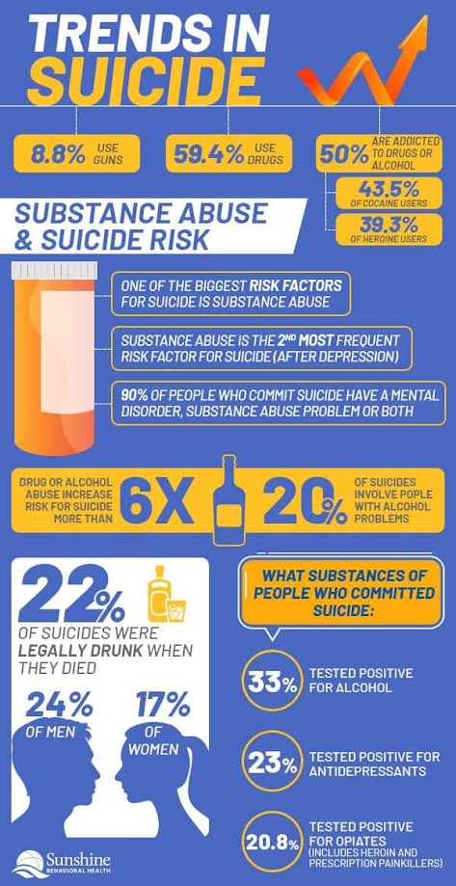

Senseless suicide
Notes:
This slide connects alcohol misuse with increased suicide risk. When judgment is impaired by drinking, permanent decisions can happen in moments of crisis.”
“Over 22% of suicides involve alcohol, and accessibility to firearms makes the risk even greater.”
“These are not isolated issues — alcohol, access, and untreated stress combine into deadly situations.”
“If you ever see someone struggling — mood changes, withdrawal, hopelessness — ask, care, and escort. Don’t assume they’ll be okay.”
“Our goal is prevention — to stop a temporary problem from becoming a permanent outcome.”

Slide 12
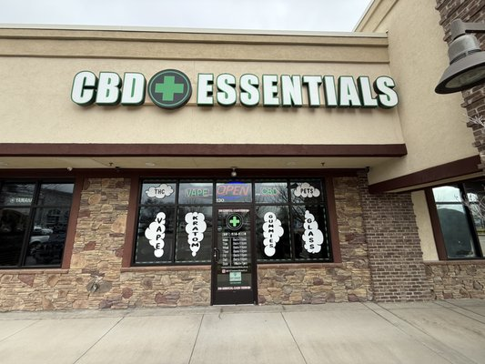


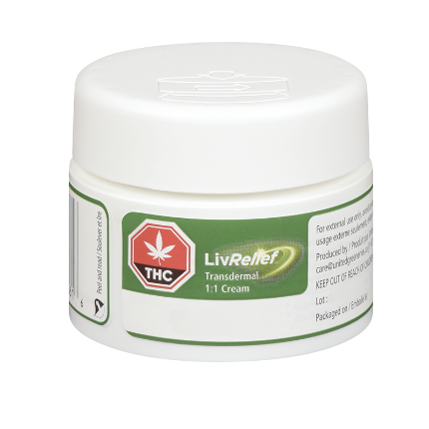
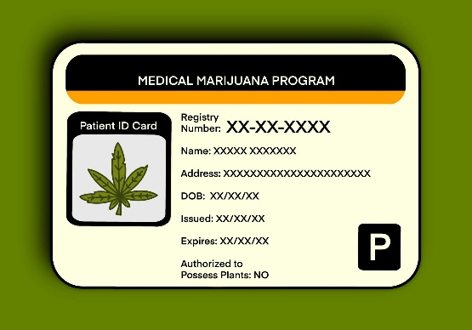
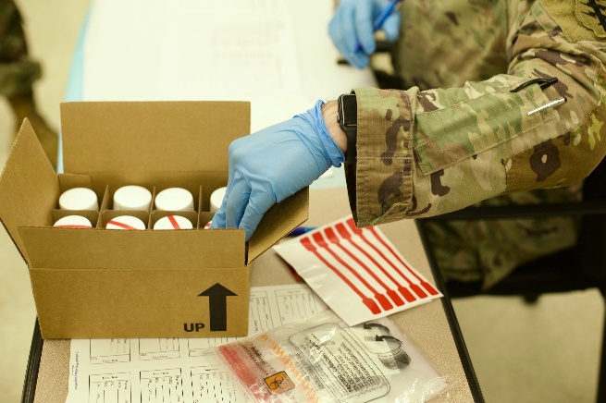
Marijuana/THC/CBD
Notes:
Marijuana isn’t just about smoking anymore. It is available in multiple forms, and can be accessed easily. But even if it is legal, it is not allowed in the military.

Slide 13
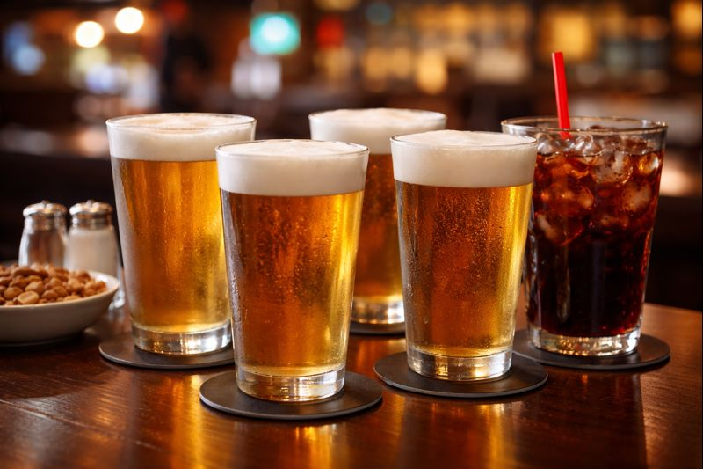
Drink with me
Notes:
Talk about unit culture, what is the attitude around drinking (edit this slide)

Slide 14



Decide sooner
Notes:
Too often we start looking at our choices when things fall apart, or explode. It isn’t until a positive UA or a DUI or a fight with a loved one that we wonder what we are doing wrong. The secret is to think through what leads to those explosive consequences, and what choices we can make EARLIER so that they don’t happen and so we can stay on track, stay ready.

Slide 15

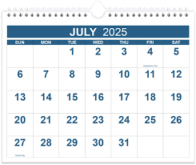

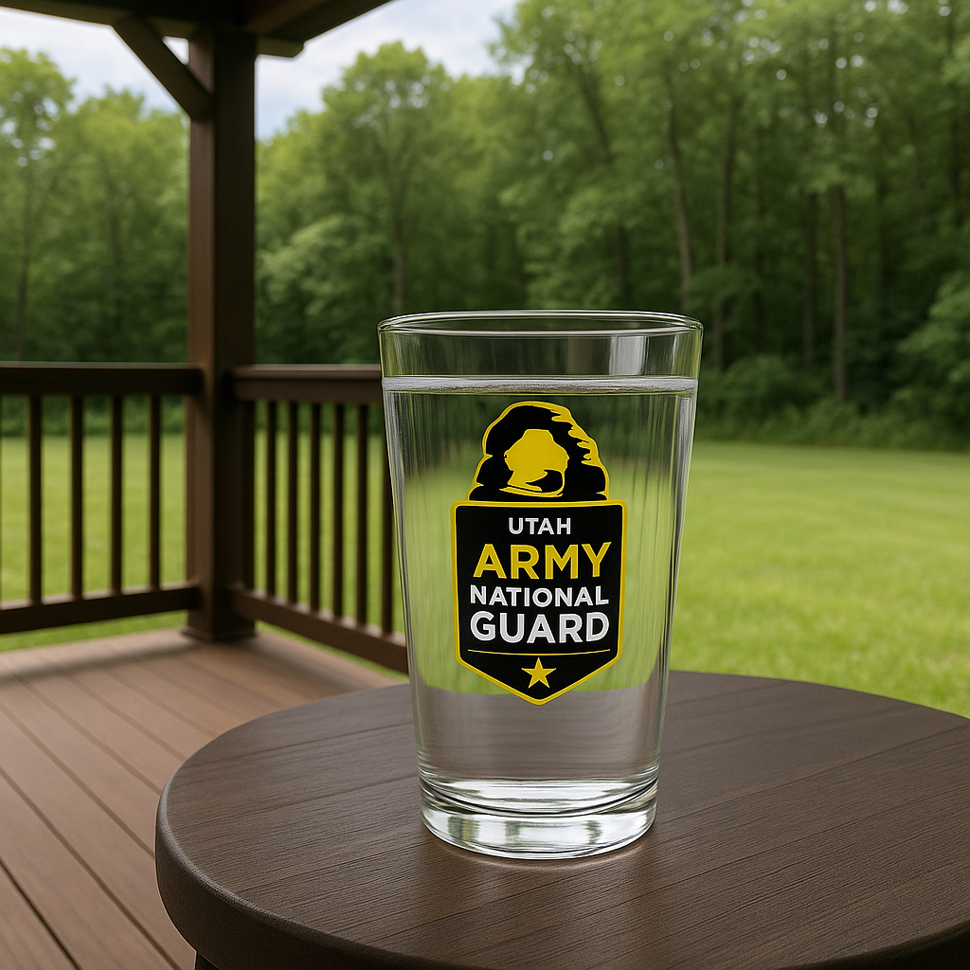
Drink on purpose
Notes:
“Now, let’s talk about drinking intentionally—or as we say, ‘drink on purpose.’
That means understanding why you’re drinking, when, and how much. It’s not about shaming anyone who drinks—it’s about promoting responsibility.
Ask yourself: ‘Am I drinking because I enjoy the taste and the company, or because I’m trying to escape something?’
If you can’t clearly define your limit, then your limit will define you. Knowing your boundaries and staying within them is what responsible drinking looks like.”

Slide 16
What are you getting out of this?
Substance | Motivations | Healthy Approaches
Alcohol | Escape/Avoidance/Coping Winding down/relaxing Social connection or pressure Sense of control (all) | Breath work and meditation Relationships/support systems Alternative drinks/rituals
Marijuana | Sleep Anxiety management Social connection Mental health symptoms | Spirituality/rituals Sleep hygiene Hobbies (all)
Opioids | Pain management Euphoria Escape/avoidance/coping | Meditation Grounding/ Mindfulness
Stimulants | Functioning Focus Energy management Deal with pressures/demands | Caffeine in moderation Breath work Exercise
Notes:
“When you make a choice—whether it’s drinking, skipping the gym, or zoning out on your phone—ask yourself: what am I really getting out of this?
If the answer is, ‘I’m avoiding stress,’ or ‘I’m numbing out,’ that’s not a long-term solution.
The idea is to be intentional with your decisions. Don’t just drink or use out of habit—do things on purpose, with purpose. If it doesn’t add value to your life, maybe it’s time to re-evaluate the role it plays.”

Slide 17


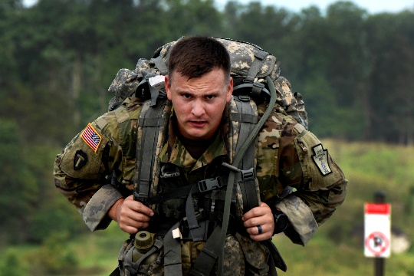
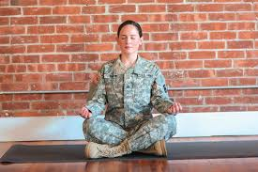
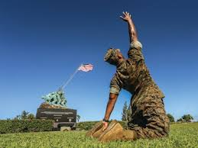
Habits and discipline
Notes:
“Our habits are the foundation of our discipline. Every time we choose to get up on time, finish a workout, or complete a task without cutting corners, we’re building self-discipline.
Discipline is what keeps us mission-ready when motivation fades. And it’s not just about the uniform—it’s about who we are off duty too. Healthy eating, responsible choices, and strong routines protect both the soldier and the person behind the rank.”

Slide 18


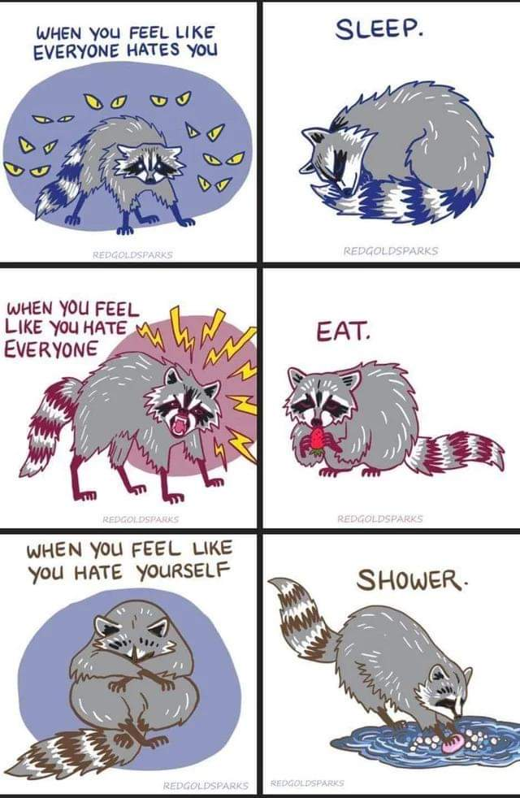
Individual: healthy habits
Notes:
“Think about one healthy habit you could improve. It could be drinking more water, setting a bedtime, cutting back on caffeine, or committing to a morning workout.
It’s easy to overlook the small things, but small habits compound over time. The soldier who builds healthy daily habits is more reliable, more alert, and less likely to make poor decisions under stress.
You can even turn this into a group challenge—teams that build accountability around health see better morale and performance.”

Slide 19

Unit support
Fellow Soldiers
Leadership
Suicide Intervention Officer
Chaplain
Behavioral Health Officer
What does “Unit Culture” mean and how do you improve it?
Notes:
“Your unit culture determines your outcomes. Culture shows up in what we tolerate, what we celebrate, and how we lead.
When soldiers know they can ask for help without fear, that’s a healthy culture.
When leaders model respect, balance, and accountability, that culture spreads.
And it all ties back to the phrase: Train to the level of your life.
This means we train our habits, our decision-making, and our self-awareness with the same seriousness that we train our physical skills. Because readiness doesn’t just live in the gym—it lives in our choices every day.”

Slide 20

Risk Reduction program
Risk Reduction Coordinator
Jared Anderson
385-988-6288
jared.w.anderson4.mil@army.mil
Prevention Coordinator
Jeff Handy
801-855-6205
jeffrey.d.handy3.mil@army.mil
Prevention Coordinator
Darren Pain
385-202-9697
darren.g.pain.ctr@army.mil
https://guard.utah.gov/j9/#risk-reduction

Slide 21

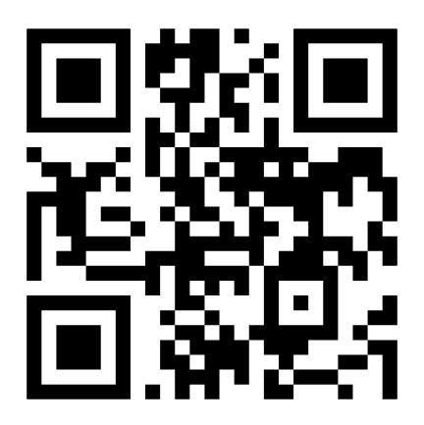
Train to the level of your life

