Slide 1
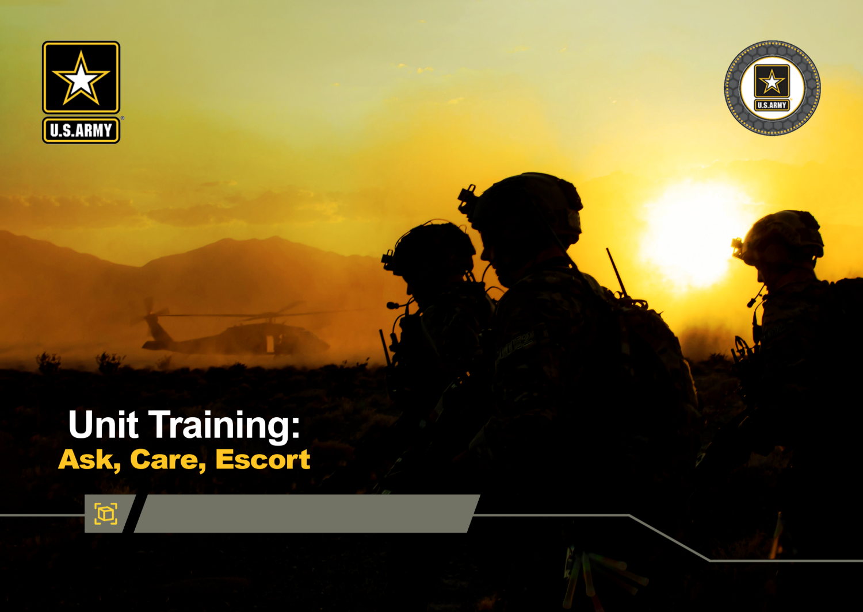



Base Module
DPRR
1
Notes:
Record your own notes here:
ACE Unit Training- Base Module
1-A

Slide 2


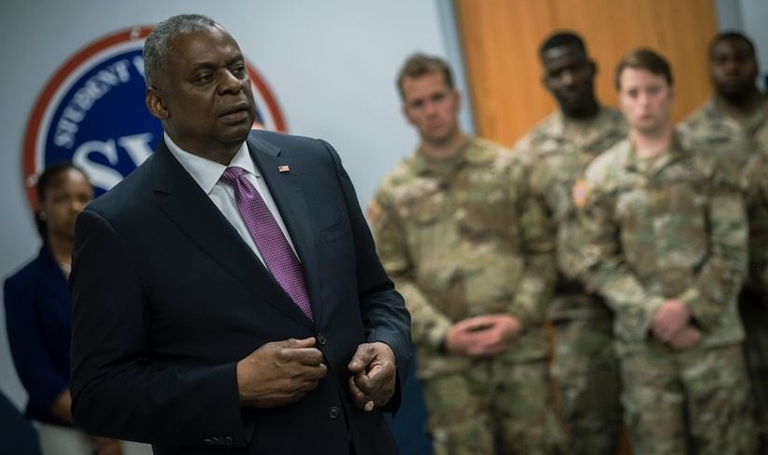
Impact of Suicide
Impact of Suicide on the Army
One suicide is too many!
Each suicide death impacts ~135 people.
“Every death by suicide is a tragedy that impacts our people, our military units, and our readiness.
That's why we remain committed to a comprehensive and integrated approach to suicide prevention.”
Secretary of Defense Lloyd Austin III
Retired U.S. Army four-star general
DPRR
2
Notes:
Record your own notes here:
2-A
ACE Unit Training- Base Module

Slide 3
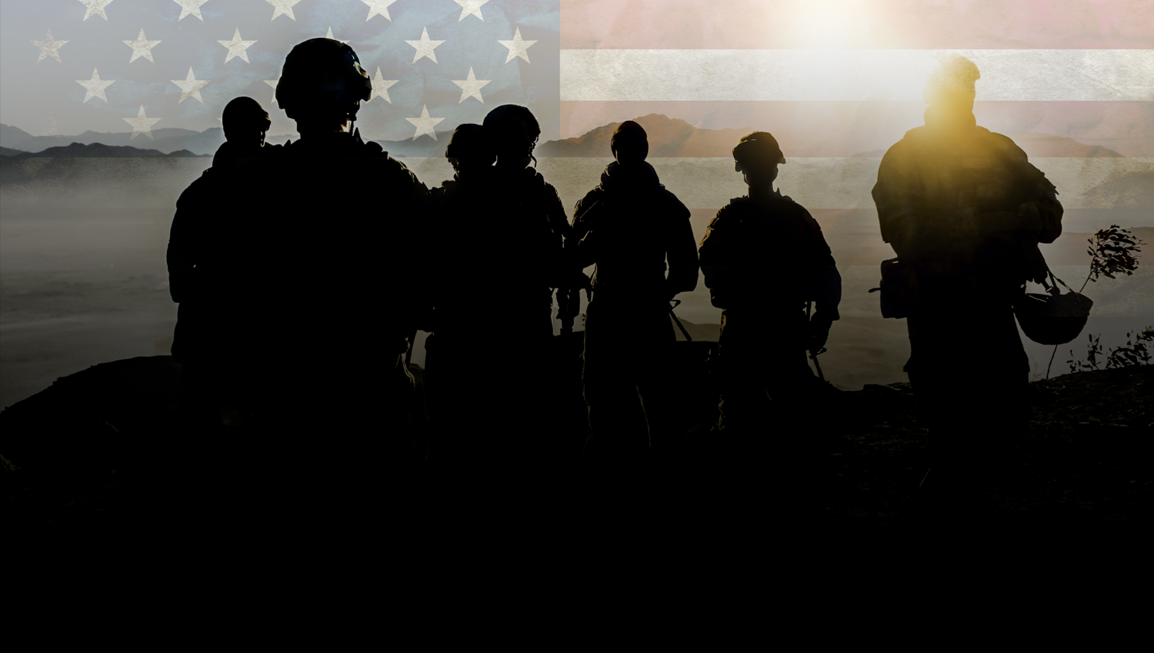


The Army Values and Suicide Prevention
ARMY VALUES
LOYALTY
Bear true faith and allegiance to the U.S. Constitution, the Army, your unit, and other Soldiers..
PERSONAL COURAGE
Face fear, danger, or adversity (physical or moral).
Which Army Value(s) do you believe are most impactful to your role in preventing suicide?
HONOR
Live up to the Army Values.
DUTY
Fulfill your obligations.
SELFLESS SERVICE
Put the welfare of the Nation, the Army, and subordinates before your own.
RESPECT
Treat people as they should be treated.
How could a Soldier leverage that value(s) to help reduce suicide in the unit?
INTEGRITY
Do what’s right, legally and morally.
3
Notes:
3-A
[?]
ACE Unit Training- Base Module
Record your own notes here:

Slide 4

Training Purpose
Training Purpose
  To increase awareness of protective factors, risk factors, and warning signs that contribute to a person’s level of risk for suicide
  To equip you with specific actions that can be taken to bolster protective factors, mitigate risk, and intervene in a crisis in order to help prevent suicide by utilizing the steps Ask, Care, Escort (ACE)
4
Notes:
Record your own notes here:
[NOTE: The Terminal Learning Objective (TLO) is as follows:
Action: Understand suicide as a complex issue and describe how to utilize the steps of Ask, Care, Escort to recognize individuals struggling to cope with life challenges and intervene to prevent suicide
Condition: In a classroom environment, given training materials
Standard: Participants will, with 100% accuracy as assessed by the instructor
recognize the role of risk and protective factors in determining suicide risk
identify warning signs indicating a person may be suicidal and in need of help
list the steps of ACE
understand how and when ACE can be applied (both as early prevention and during a crisis)
There will be checks on learning throughout the training to ensure the objective and standards are being met.]
4-A
ACE Unit Training- Base Module

Slide 5

Recognize the Signs to Assess Risks
WARNING SIGNS
  Time-sensitive concerns for suicide risk
  Stop and deal with this NOW
RISK FACTORS
  Issues that increase suicide risk
  Check in and follow up
PROTECTIVE FACTORS
  Behaviors or supports that reduce risk
  Encourage healthy behaviors
5
Notes:
Record your own notes here:
[NOTE: IAW ATP 5-19, managing risk is a process of identifying, assessing, and controlling risk arising from a recognized set of factors.]
5-A
ACE Unit Training- Base Module

Slide 6
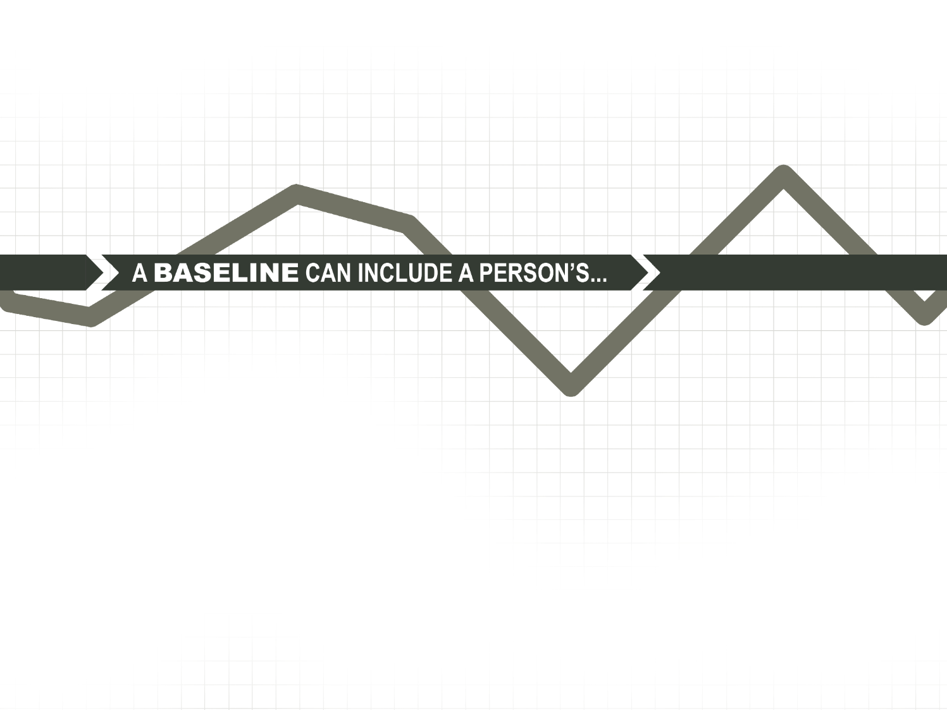
Establish a Baseline
Typical behaviors and moods
Typical reactions to stress or typical coping behaviors
General information (e.g., relationship or family status, hobbies)
Knowing the BASELINE of those around you is foundational to recognizing change and identifying risk.
6
Notes:
6-A
ACE Unit Training- Base Module
Record your own notes here:

Slide 7

Protective Factors
Protective factors are skills, strengths,
or resources that help people deal more effectively with stressful events
What are some examples of protective factors that can help offset or mitigate risk?
To help offset or mitigate risk:
  Use productive coping skills
  Be willing to talk with others
  Cultivate strong personal relationships and unit cohesion
  Utilize professional resources
  Connect to a strong sense of purpose
7
Notes:
7-A
ACE Unit Training- Base Module
Record your own notes here:
[?]

Slide 8




Use ACE to Strengthen Protective Factors
ASK how they are doing or about a specific aspect of their life
Show you CARE by actively listening and show interest in what they share
ESCORT by encouraging proactive use of resources
How could you use each step of ACE to enhance protective factors within your unit?
8
Notes:
8-A
ACE Unit Training- Base Module
[?]
Record your own notes here:

Slide 9
Protective Factors
You have likely developed skills, strengths, and utilized resources that help you to effectively cope with and overcome challenges.
Everyone still has some level of risk.
Protective factors help decrease the chances that a combination of risk factors result in negative outcomes.
9
Notes:
9-A
ACE Unit Training- Base Module
Record your own notes here:

Slide 10




Suicide Risk Factors
We all manage life’s challenges differently. How we manage life issues can be protective or can increase our risk for negative outcomes.
RISK FACTORS
Changes in behavior such as:
  Avoiding friends or isolating
  Dramatic mood changes
  Anger or irritability
  Anxiety or depression
  Inability to sleep
  Poor coping mechanisms
Additional Risk Factors:
  Family/loved one’s history of suicide
  Loss, conflict, or change in relationships
  Bullying or discrimination
  Job/financial problems or loss
  Substance use
  Sense of hopelessness
10
Notes:
10-A
ACE Unit Training- Base Module
Record your own notes here:

Slide 11

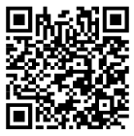
Non-Emergency Resources
Local Resources
General Resources
Army Community Service (ACS): _______________
Military Family Life Counselor (MFLC): _____________
Ready & Resilient Performance Centers (R2PCs)
Army Wellness Center (AWC)
Behavioral Health or Primary Care
Chaplain Services/Local Pastor
Unit Chaplain ________________
Holistic Health and Fitness (H2F) Personnel
American Legion/VFW
Department of Social Services (by state)
Faith-based services or local church
DoD or VA
  Military OneSource: 800-342-9647; militaryonesource.mil/; chat via website
  Psychological Health Resource Center: 866-966-1020; pdhealth.mil/resources; chat via website
  Real Warriors campaign: realwarriors.net; chat via website
  My VA 311: 844-MyVA311 (844-698-2311)
  Vet Center Call Center: 877-WAR-VETS
  Community Resources Guide: crg.amedd.army.mil
  Other
  Dial 211 or https://www.211.org
  Department of Social Services (by state)
Who is your go to person?
Friends and family
Unit Chaplain
Line leader
J9 Resiliency Directorate
Military Family Life Consultant
  Duncan Shumway, 801-716-9228
Soldier and Family Readiness
  Ashley Warren, 801-432-4522
988
Tactical Environments
Battalion Aid Stations
What other non-emergency resources do you know of?
11
Notes:
Record your own notes here:
[NOTE: Be sure to add contact information for local resources prior to the training.]
11-A
ACE Unit Training- Base Module

Slide 12

Use ACE to Mitigate Risks
ASK if they are okay and if you can help
Show you CARE by listening to their problem
ESCORT them to an appropriate helping resource
Choose a risk factor. How could you use each step of ACE to help the Soldier mitigate the risk?
FACTORS
  Avoiding friends or isolating
  Dramatic mood changes
  Anger or irritability
  Anxiety or depression
  Inability to sleep
  Poor coping mechanisms
  Family/loved one’s history of suicide
  Bullying or discrimination
  Loss, conflict, change in relationships
  Job/financial problems
RISK
12
Notes:
12-A
ACE Unit Training- Base Module
[?]
Record your own notes here:

Slide 13


Debrief: Identify and Mitigate Risks
What risk factor did you choose to discuss, and how could you use each step of ACE to help the Soldier mitigate their risk?
When using ACE to mitigate risk, how might that also be strengthening a protective factor?
Using ACE early at the sign of concern can stop some problems and stressors from growing and becoming overwhelming to the point of crisis.
CUI
13
Notes:
13-A
ACE Unit Training- Base Module
[?]
Record your own notes here:

Slide 14


Suicide Warning Signs
There are signs that may indicate someone is contemplating suicide.
WARNING SIGNS
  Talking about death
  Giving belongings away
  Talking about harming oneself
  Regularly isolating
  Change in behavior
If you see a red flag (a warning sign or a sense something is “off”), take immediate action.
14
Notes:
14-A
ACE Unit Training- Base Module
Record your own notes here:

Slide 15
Emergency Resources
Local Resources
Crisis Hotlines
Your chain of command _____________________
Emergency Room _____________________
Local Emergency Resources
  (Dial 9-1-1)
Military Police _____________________
Civilian Police _____________________
ACE-SI
_____________________
Military/Veterans Crisis Line:
    North America: Dial 988, Press 1
      Text: 838255
    Europe: 00800 1-273-8255 or DSN 118
    Korea: 0808-555-118 or DSN 118
Veterans Crisis Line Online Chat: www.veteranscrisisline.net/chat
Lifeline Crisis Chat: www.crisischat.org
National Suicide Prevention Lifeline:
1-800-273-TALK (8255). Press 1
Suicide Hotlines (by State): http://www.suicide.org/suicide-hotlines.html
Chain of Command
Chaplain
  Unit
  State: 801-716-9036
911 (also have Social Workers)
SafeUT
Huntsman: 801-587-3000
  (Mobile Crisis Response Team)
Psychological Health
  Sarah Larmore:
  801-716-9009
  Aaron Baxter
  801-716-9068
  DPH Crisis Line (Business Hours) 801-432-4367
Sexual Assault Response
  Andrew Kalinen:
  801-716-9254
988
OCONUS Emergency Services (911)
Germany: Dial 112
Italy: Dial 112,118
South Korea: Dial 119
CUI
15
Notes:
Record your own notes here:
[NOTE: Be sure to add contact information for local resources prior to the training.]
15-A
ACE Unit Training- Base Module

Slide 16

Use ACE to Address Warning Signs
ASK directly if they are thinking of killing or harming themselves
CARE by listening and showing support
ESCORT them directly to an emergency helping resource; do not leave them alone
What have you done in the past, or can you do, to stay calm and composed when facing a crisis?
16
Notes:
16-A
[?]
ACE Unit Training- Base Module
Record your own notes here:

Slide 17
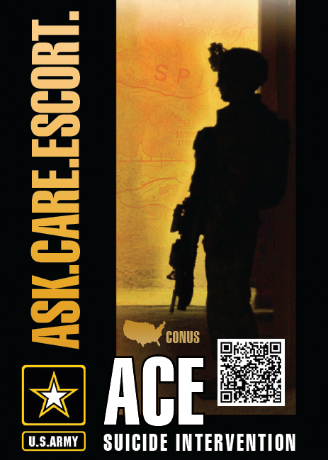
Debrief: Warning Signs
What are the warning signs that can indicate a person might be contemplating suicide and require you to take immediate action?
How could you use the steps of ACE during a crisis situation?
17
Notes:
17-A
ACE Unit Training- Base Module
[?]
Record your own notes here:

Slide 18

You are Equipped to Take Action!
You are now equipped to use ACE to bolster protective factors, mitigate risk, and support a Soldier in a crisis.
You cannot stand by and assume a person will reach out in a time of struggle or despair. A key takeaway from this training is to take initiative!
18
Notes:
18-A
ACE Unit Training- Base Module
Record your own notes here:

Slide 19
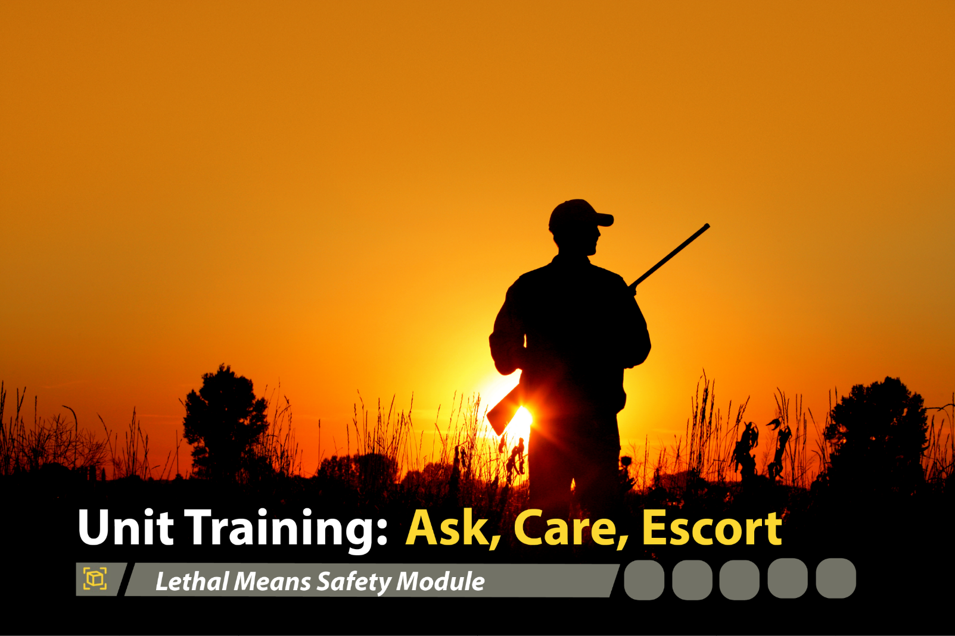


Lethal Means Safety Module
1
Notes:
Record your own notes here:
ACE Unit Training- Lethal Means Safety Module
1-A

Slide 20
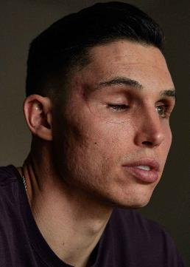

Concrete Experience: The Story of Drew Robinson
Impact of Suicide on the Army
Drew Robinson was once known for being a Major League Baseball (MLB) player of the Texas Rangers and the St. Louis Cardinals. While having achieved his goal of making it to the big leagues, his experience was anything but easy. He had been demoted to the minor leagues several times, and he had injured his left elbow and required surgery. In August of 2019, the Cardinals released him. Despite his continuation with behavioral health therapy, he felt increasingly frustrated with himself and he was worried he was going to end up in the minor leagues again. Little did anyone know that Drew suffered from
depression and suicidal ideation. Drew felt as though he was not good enough for his fiancée and he called off the wedding. After becoming increasingly isolated by the COVID-19 pandemic, he asked himself, “Who would care if I’m gone?” That evening, on April 16, 2020, Drew sat on his living room couch, drinking whiskey, and shot himself in the right temple. Drew Robinson survived.
What risk factors or warning signs can you identify in Drew’s story? If he was one of your friends, what would you do?
2
Notes:
Record your own notes here:
[NOTE: The Drew Robinson story was chosen to be used with the Soldier population for various reasons: (1) as a survivor and as a mental health advocate, Drew is able to share his story in a way that others can empathize and learn from; (2) there is a level of separation for the Soldiers to focus on an athlete rather than a comrade in arms; (3) Soldier examples have potential to distract from the key points (e.g., fixate on nuances) whereas Drew’s story can be reviewed with more objectivity; and (4) Soldiers can continue to learn from Drew and his story via the abundance of stories and videos available (e.g., a one hour documentary on ESPN titled, “E60: Alive - The Drew Robinson Story”)]
2-A
ACE Unit Training- Lethal Means Safety Module
[?]

Slide 21

Training Purpose
To enhance Soldiers’ understanding of Lethal Means Safety (LMS)
To provide an opportunity for Soldiers to consider and discuss ways to promote LMS for themselves and others
To help Soldiers prevent suicide in their unit and in their circles of support
3
Notes:
3-A
ACE Unit Training- Lethal Means Safety Module
Record your own notes here:
[NOTE: The Terminal Learning Objective (TLO) is as follows:
Action: Understand how lethal means safety is critical to suicide prevention and intervention efforts.
Condition: In a classroom environment, given training materials.
Standard: Participants will, with 100% accuracy as assessed by the instructor.
Recognize the role of lethal means safety in suicide prevention.
Describe how safely storing lethal means can lengthen the time from suicidal thoughts to suicidal acts.
Consider how using ACE can promote lethal means safety.]

Slide 22

Lethal Means, Lethality, and Influencing Factors
Lethality: the capacity to cause death or serious harm or damage
Lethal Means: the methods that can be used in a suicide attempt
Influencing factors:
Ease of accessibility and use
Acceptability to the attempter
Inherent deadliness
Ability to abort mid-attempt
Why might the lethality rate be higher for firearms, jumping, or hanging versus drug poisoning or cutting?
4
Notes:
Record your own notes here:
4-A
ACE Unit Training- Lethal Means Safety Module

Slide 23

Lethal Means Safety in Action
The goal of lethal means safety is to put time and distance between a means of suicide and a person at risk for suicide, thus making immediate access to the means more difficult and ultimately lowering the risk of death by suicide.
Practicing lethal means safety to prevent loss of life.
lock firearms
separate the ammunition from the firearm
use gun locks and breach barriers
take away firing pins
lock pharmaceuticals / medication
use tear-resistant bedsheets
5
Notes:
5-A
ACE Unit Training- Lethal Means Safety Module
Record your own notes here:

Slide 24
Debrief Discussion Questions
What does LMS look like as a protective factor? How does having a conversation about LMS work as a protective factor?
What does LMS look like for addressing risk factors? How can the knowledge of LMS work to mitigate risk factors?
What does LMS look like when you identify warning signs? How does LMS reduce the risk of suicide when warning signs are present?
1
1
2
2
3
3
7
Notes:
7-A
ACE Unit Training- Lethal Means Safety Module
Record your own notes here:
[?]

Slide 25
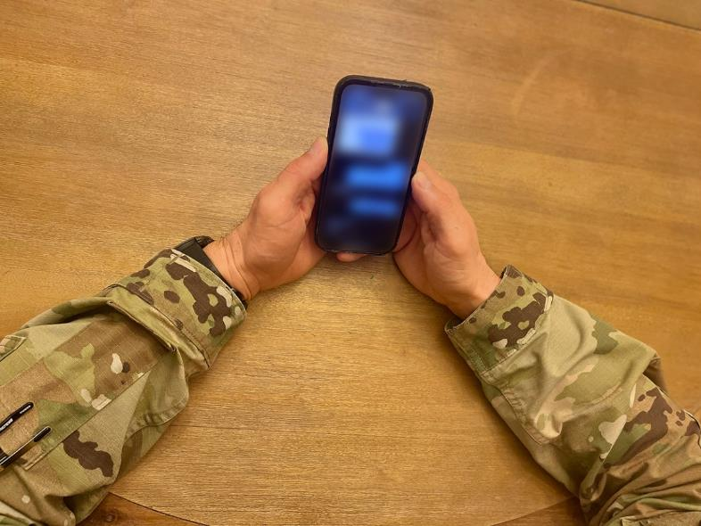
Lethal Means Safety from a Distance
Based on the discussion we just had, what are some ways you can help other Soldiers or Circle of Support members with lethal means safety when you are not physically present?
8
Notes:
8-A
ACE Unit Training- Lethal Means Safety Module
Record your own notes here:

Slide 26
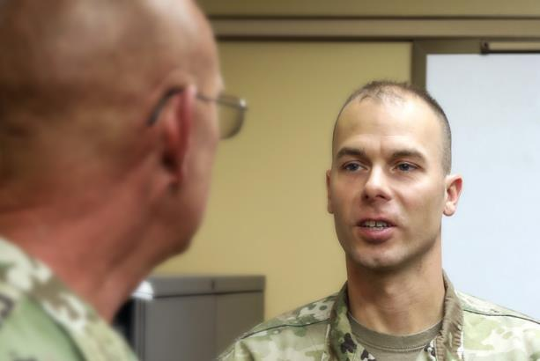
Next Steps: Plan to Implement
What is one thing you plan to do within the next week or two that can help lower the risk of suicide within your unit or among your friends and family members?
Preventing suicide requires taking proactive steps
7
Notes:
9-A
ACE Unit Training- Lethal Means Safety Module
Record your own notes here:
[?]

Slide 27

Have that Conversation
You know someone who has not secured their lethal means.
Demonstrate care by having that conversation with your friends and loved ones.
Lethal means safety plays an important role in suicide prevention and intervention.
10
Notes:
10-A
ACE Unit Training- Lethal Means Safety Module
Record your own notes here:

